Slide 1
Roscoe Collegiate I.S.d.
2022 – 2023 District Annual Report
PUBLIC HEARING
January 22, 2024

Slide 2
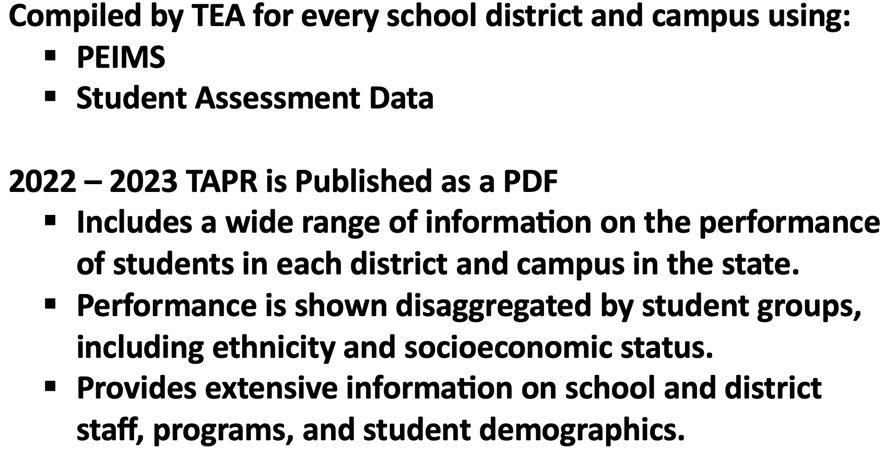
TAPR: Texas Academic Performance Report
2022-2023

Slide 3
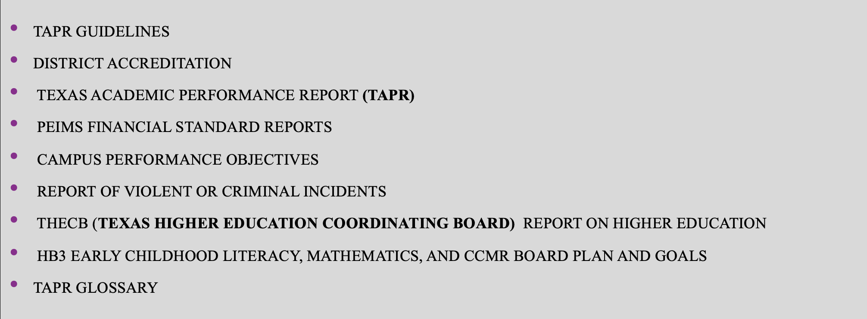
Components of the Annual Report

Slide 4
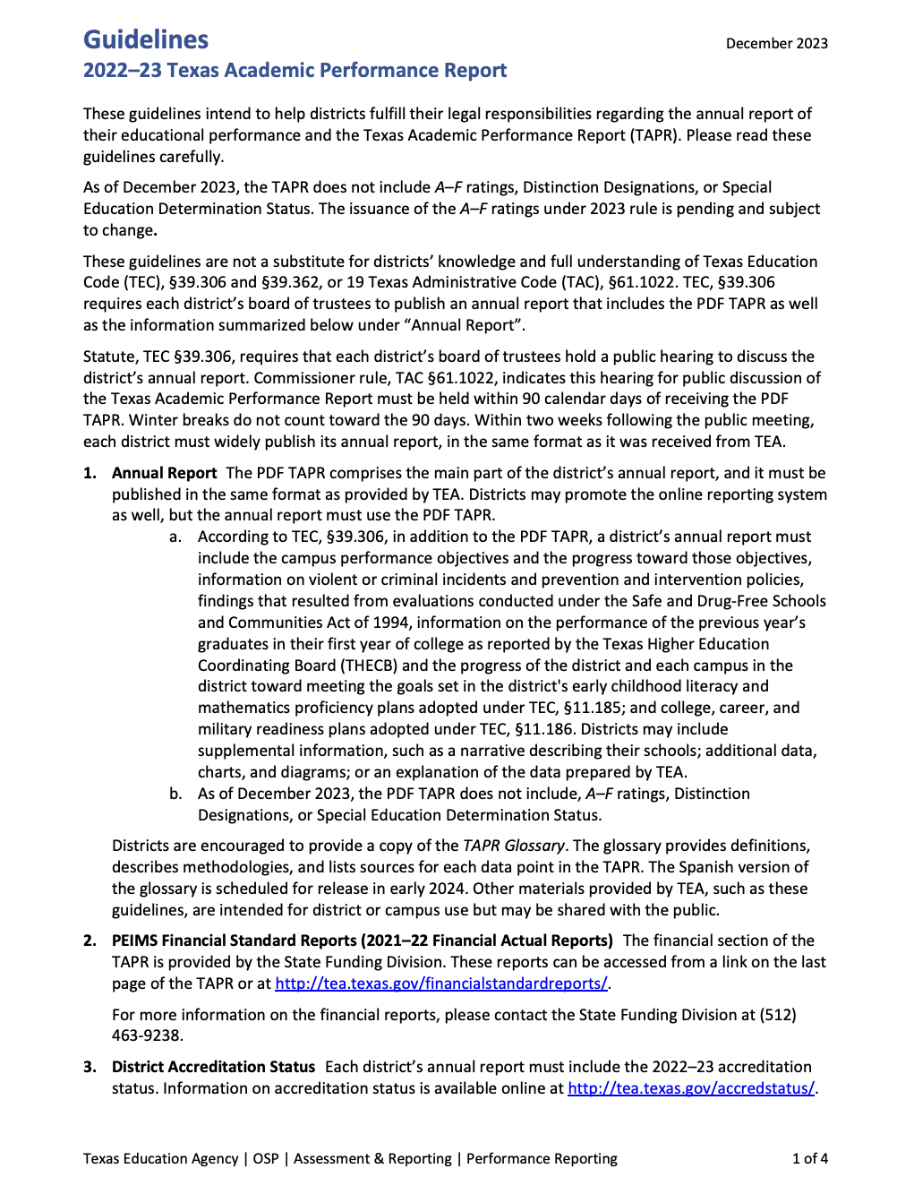
TAPR Guidelines
Link to TAPR Guidelines
Public Notification Requirements

Slide 5
2022-2023 District Accreditation status
2022 First Rating: A – Superior Achievement
2022 Accountability rating: b
2022 – 2023 accreditation status: accredited
2022 special education determination status: not available as of December 2023.

Slide 6
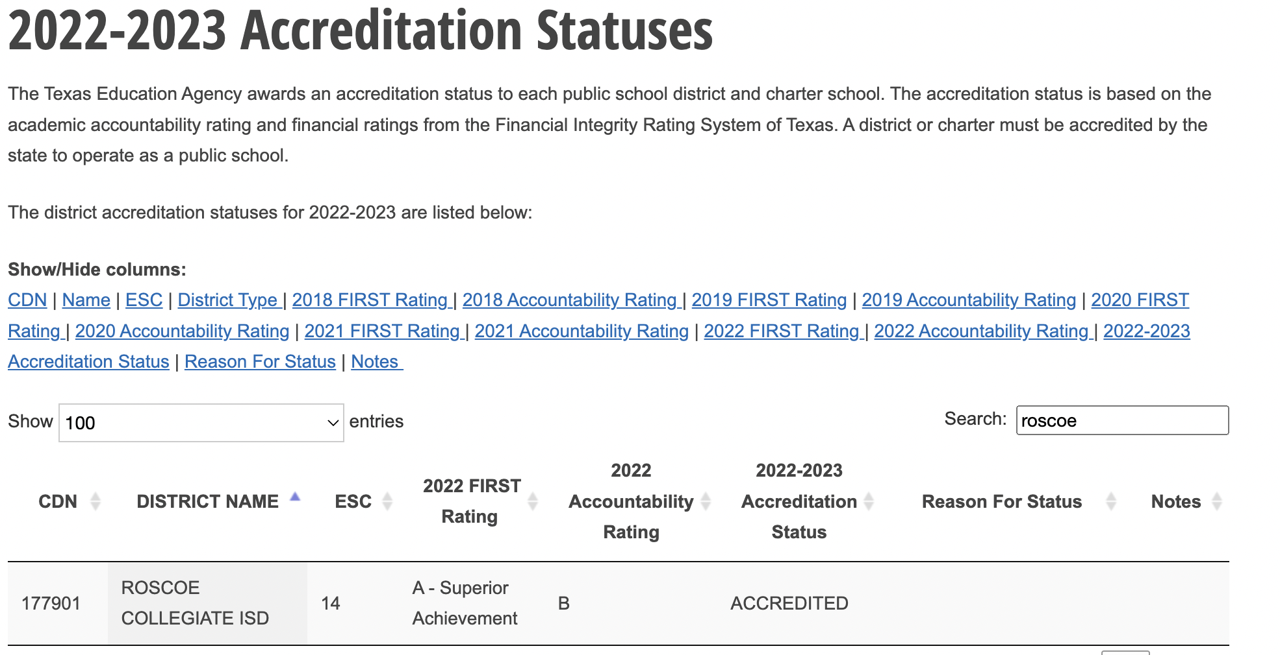

Slide 7
CAMPUS ACCOUNTABILITY RATINGS
2022 - 2023
AS OF DECEMBER 2023, THE PDF TAPR DOES NOT
INCLUDE A-F RATINGS!
Ratings have not been released from the state!

Slide 8
2022-2023 RCISD -TAPR Reports
Links to TAPR reports
ROSCOE HIGH SCHOOL
Roscoe Elementary
Roscoe ECC
RCISD

Slide 9
2022 – 2023 TEXAS ACADEMIC PERFORMANCE REPORT (TAPR)

Slide 10
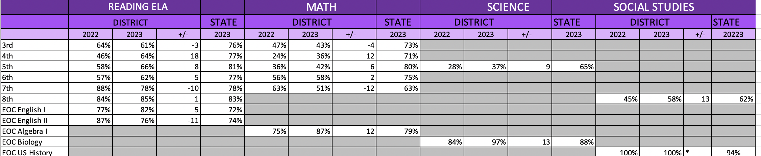
2022 – 2023 TAPR- STAAR/EOC PERFORMANCE
RCISD COMPARED TO THE STATE
ALL GRADES AT APPROACHES GRADE LEVEL

Slide 11
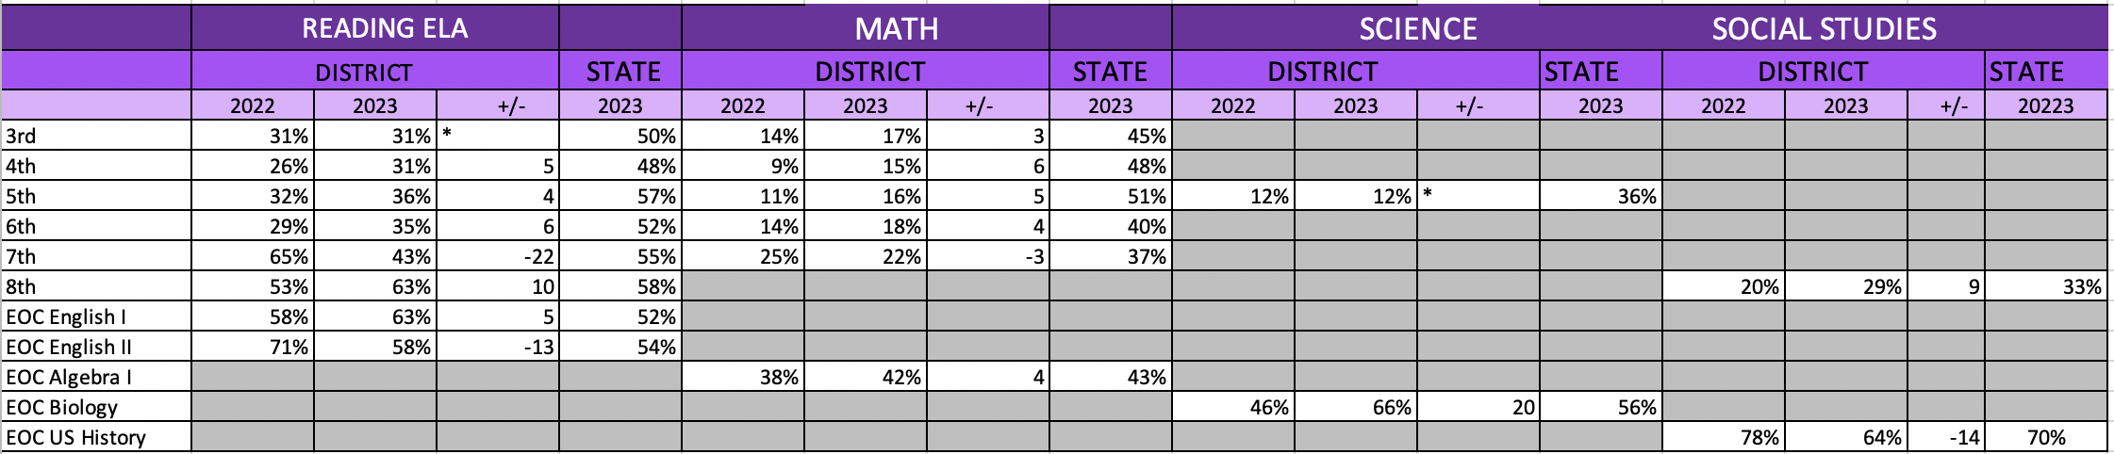
2022 – 2023 TAPR: STAAR/EOC PERFORMANCE
RCISD COMPARED TO THE STATE
ALL STUDENTS AT MEETS GRADE LEVEL OR ABOVE

Slide 12
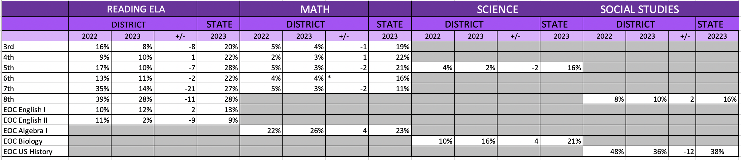
2022 – 2023 TAPR: STAAR/EOC PERFORMANCE
RCISD COMPARED TO THE STATE
ALL STUDENTS AT MASTERS GRADE LEVEL

Slide 13
ALL GRADES/ALL SUBJECTS
2022 COMPARED TO 2023-MEETS

Slide 14
2022-2023 PERECNTAGE OF STUDENTS AT MEETS GRADE LEVEL STANDARD COMPARED TO THE STATE AND THE REGION
53
52
51
45
47
45
41
41
18
17

Slide 15
All Grades/all subjects
2022 compared to 2023-MEETS
46
41
35
36
18
19
17
14

Slide 16
2022 -2023 BILLINGUAL/ENGLISH AS A SECOND LANGUAGE
(CURRENT EB/EL STUDENTS)
DATA SHOWN IS ALL GRADES/ALL SUBJECTS AT MEETS GRADE LEVEL
48
49
47
48
25
27

Slide 17
ATTENDANCE RATE

Slide 18
4 YEAR GRADUATION RATE: CLASS OF 2022
3.6
0
0
0

Slide 19
2022 – 2023 Graduate profile
Total graduates
By ethnicity
By graduation type

Slide 20
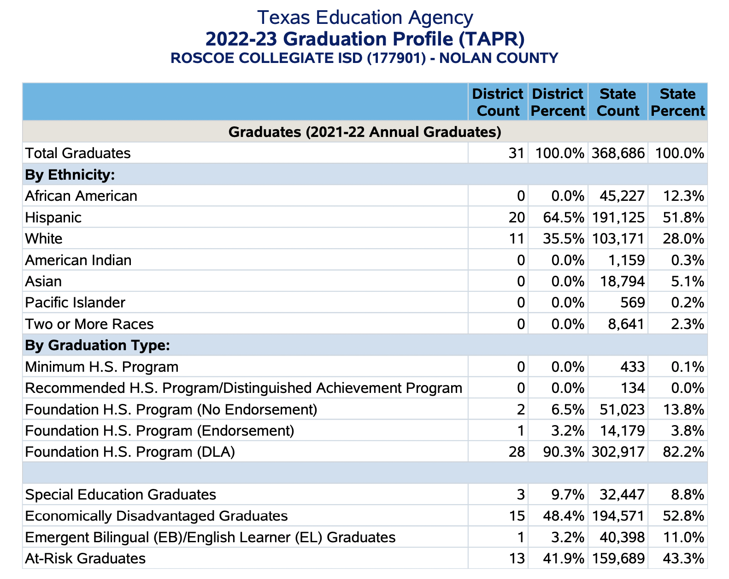

Slide 21
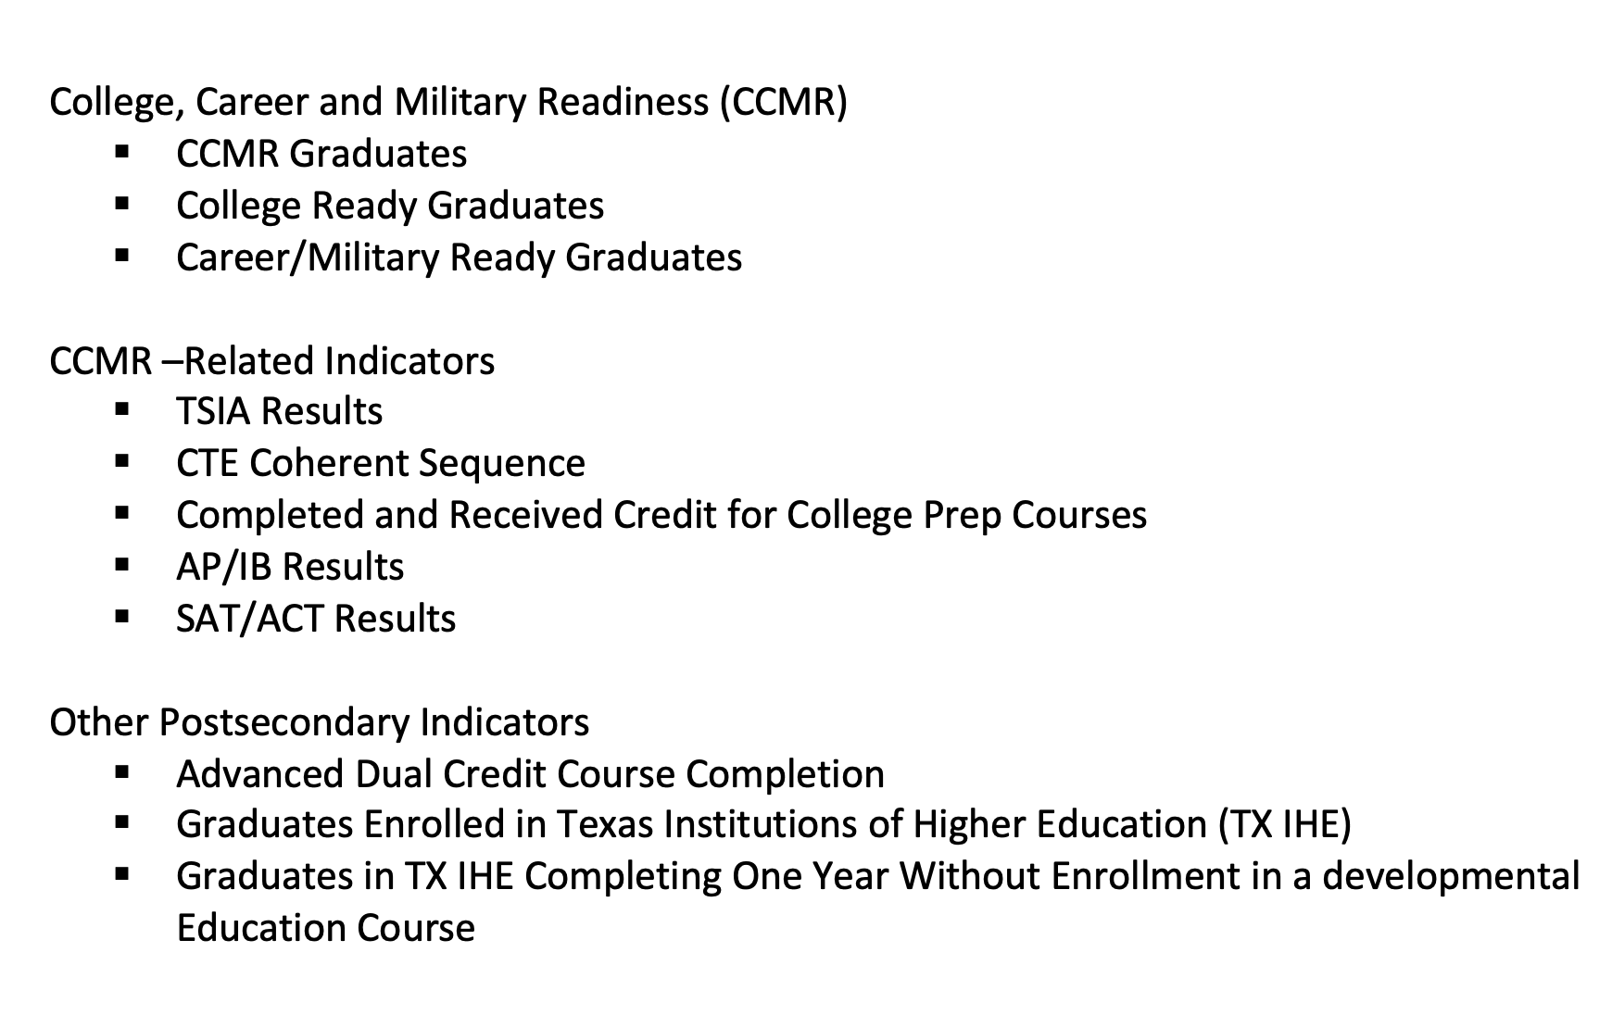
The most recent data for these measures are from the 2021 – 2022 school year. Therefore, performance on these measures is reported for the 2021 – 2022 and 2020 – 21 school years.

Slide 22
COLLEGE, CAREER, AND MILITARY READY GRADUATES:
CLASS OF 2022

Slide 23
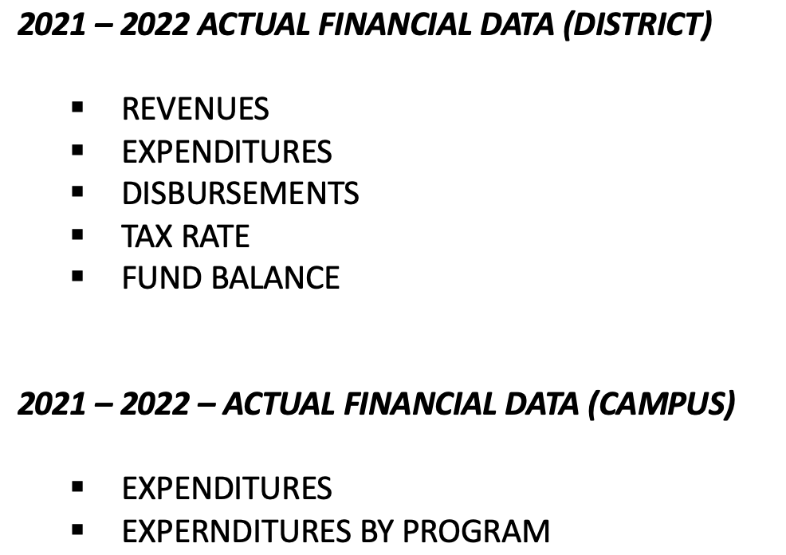
FINANCIAL STANDARD REPORTS
2023 – 2022
2021 – 2022 IS THE MOST RECENT YEAR FOR WHICH THIS DATA ARE AVAILABLE
LINK TO FINANCIAL REPORTS
PEIMS Financial Standard Reports

Slide 24
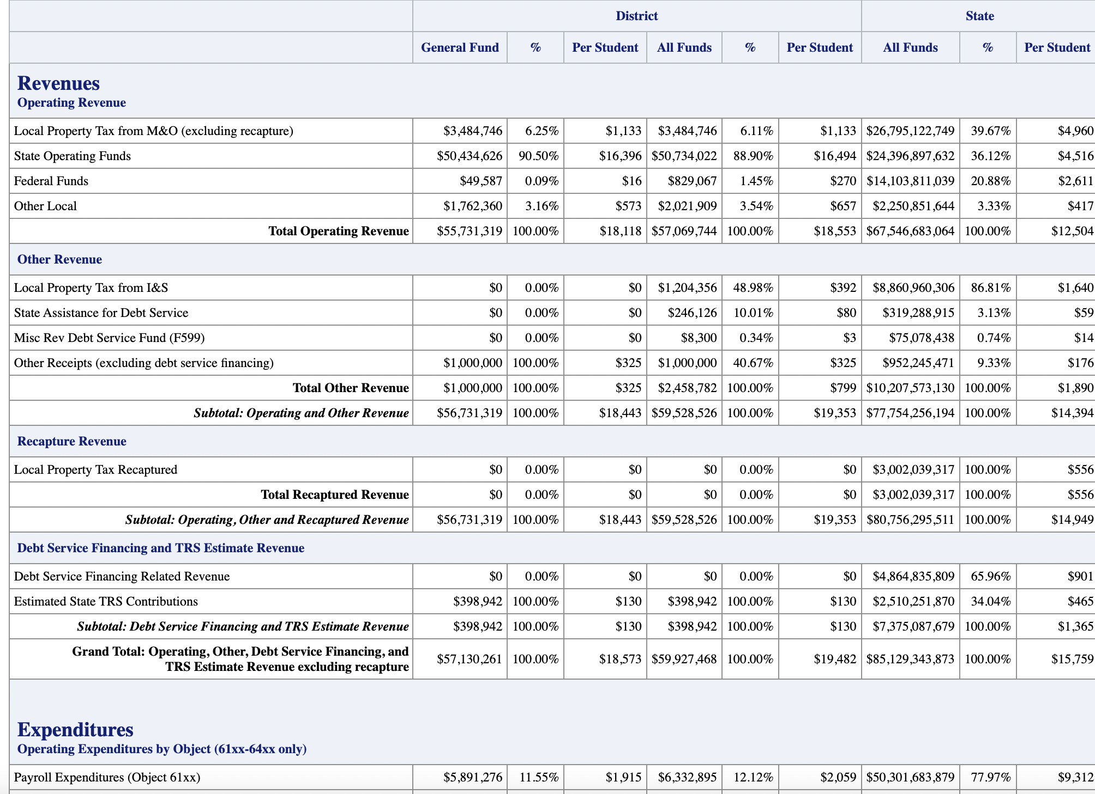

Slide 25
REVENUES: OPERATING REVENUES ALL
ALL FUNDS
89% - state
6.11% - Local property tax
3.54% - other Local
1.45% - Federal funds
89%

Slide 26
Total Expenditures: All Funds
By object

Slide 27
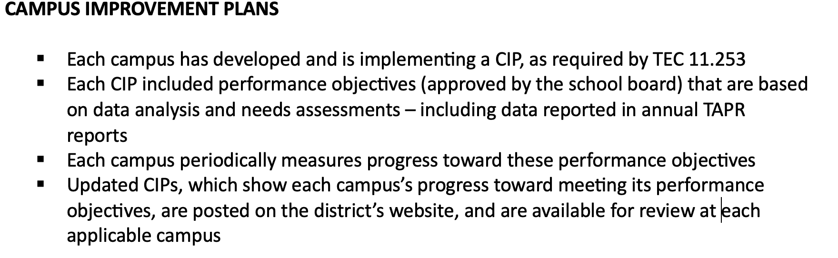
CAMPUS PERFORMANCE OBJECTIVES

Slide 28
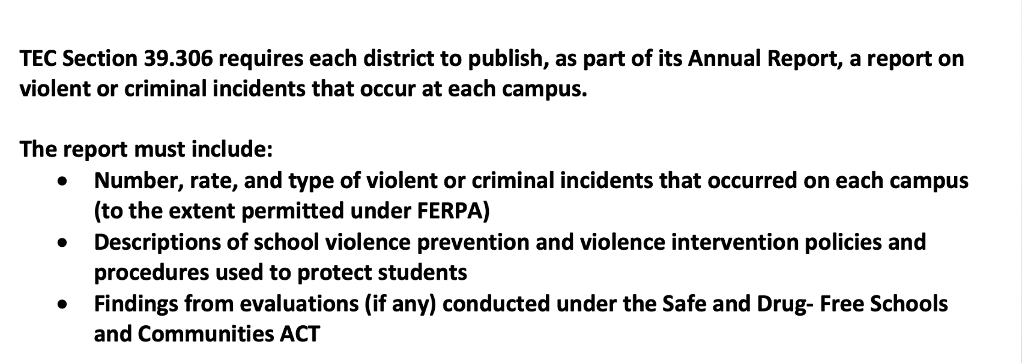
Violent or criminal incidents
** The district’s report for the 2022 -2023 school year is available for review at each campus and at central office.

Slide 29
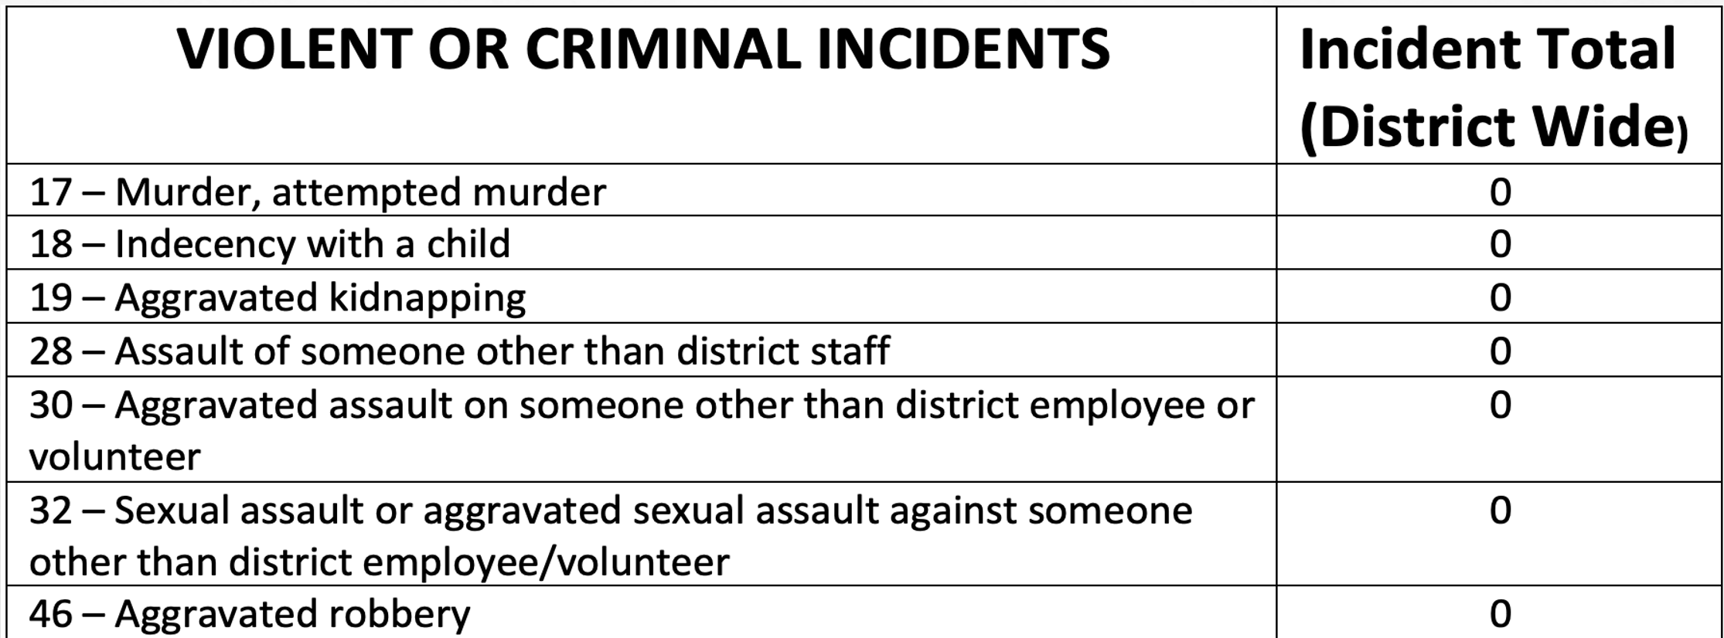

Slide 30
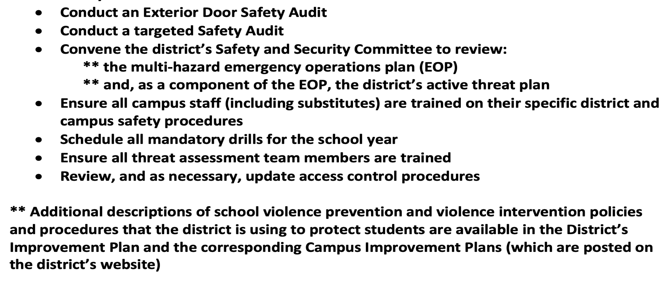
As required by TEA, the RCISD has taken the following steps prior to the start of the 2023 – 2024 school year:

Slide 31
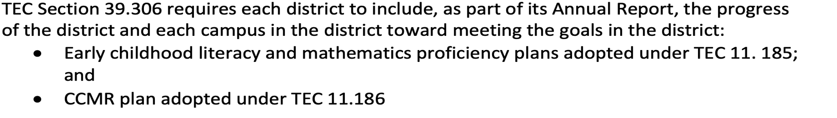
HB3 Early Childhood Literacy, mathematics, and ccmr board plan and goals
The progress made by RCISD and each campus is reported to the board each month. These goals are also posted on the RCISD website.

Slide 32
TAPR
Additional information reported on the TAPR:
Special Education Determination Status
Student Demographics
Class Size • Staff Information
Student Enrollment by Program
Teachers by Program (population served)

Slide 33
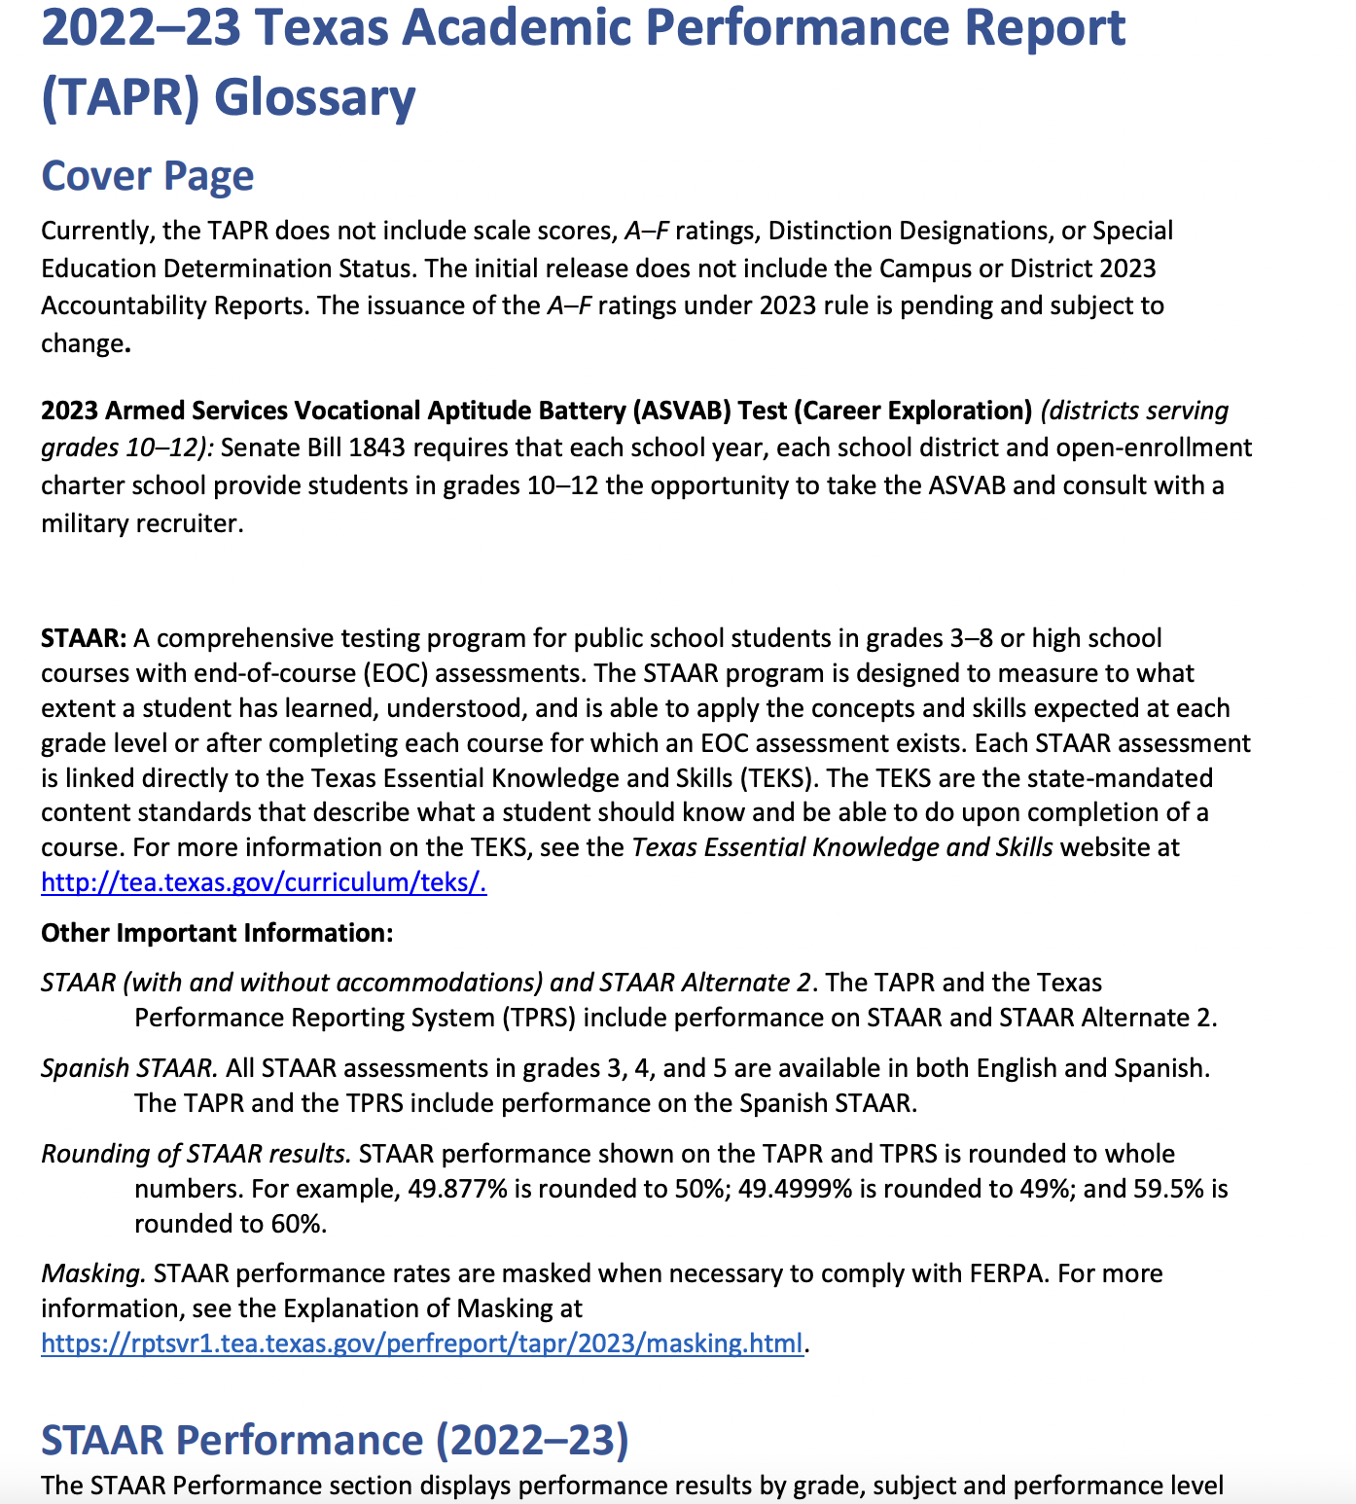
Tapr glossary
Link:
TAPR Glossary

Slide 34
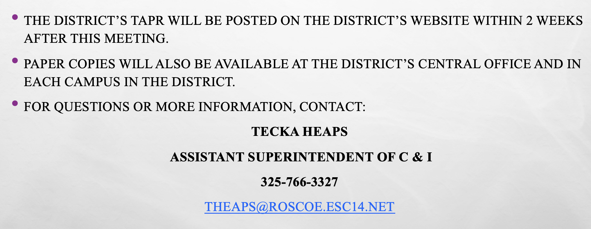
Resources and availability of Report

