Slide 1
Roscoe Collegiate I.S.d.
2023 – 2024 District Annual Report
PUBLIC HEARING
February 19 , 2025

Slide 2
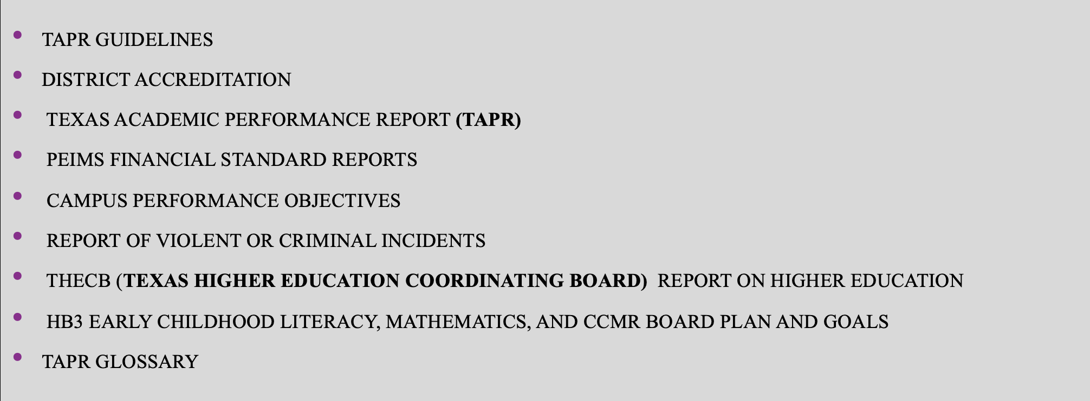
Components of the Annual Report

Slide 3
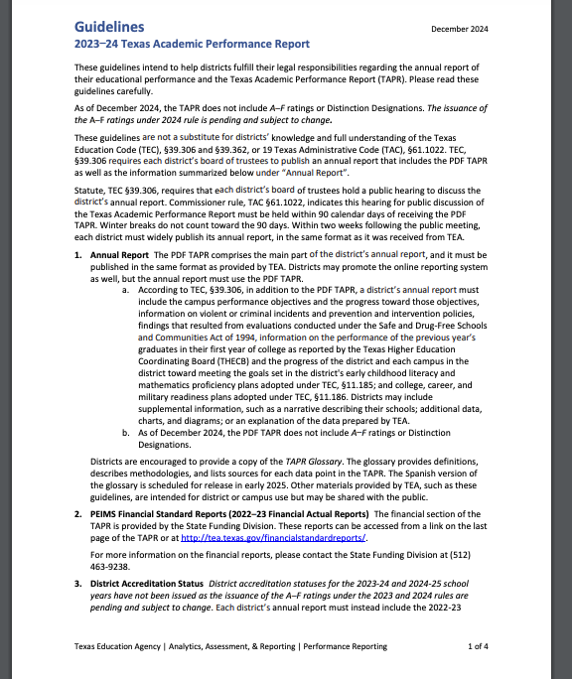
TAPR Guidelines
Link to TAPR Guidelines
TAPR Guidelines

Slide 4
2023-2024 District Accreditation status
2023 First Rating: A – Superior Achievement
2023 Accountability rating: Not available as of February 2025
2023 – 2024 accreditation status: Not available as of February 2025
2023 special education determination status: Meets Requirements

Slide 5
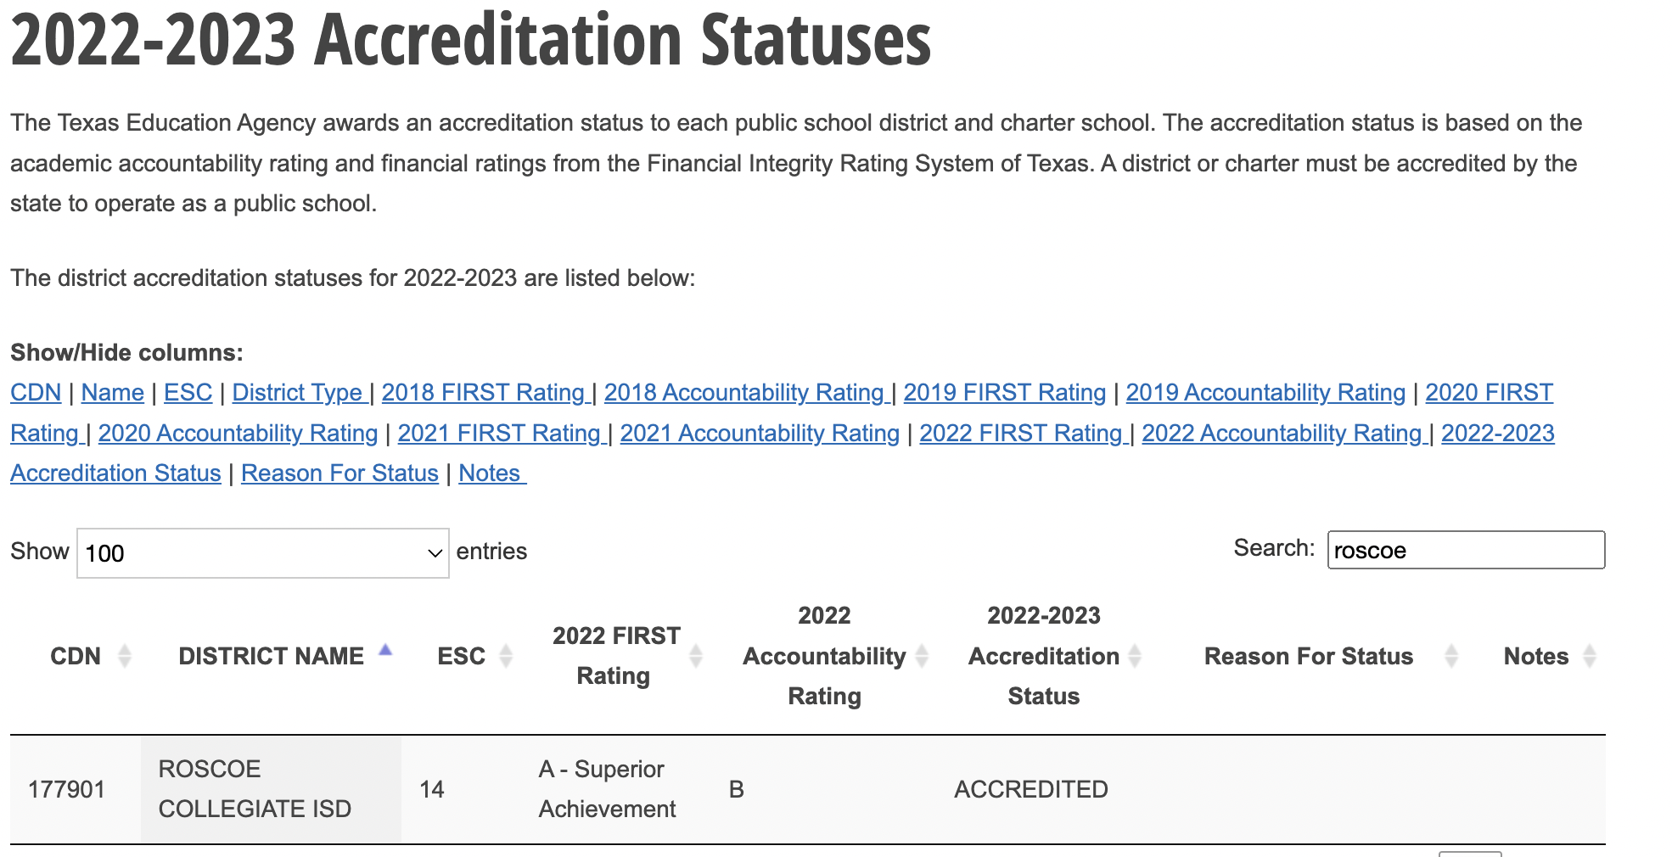

Slide 6
2023 – 2024 TEXAS ACADEMIC PERFORMANCE REPORT (TAPR)

Slide 7
Link to 2023-2024 TAPR
RCISD

Slide 8
ALL GRADES/ALL SUBJECTS
2023 COMPARED TO 2024
27
TAPR PAGES 8-9

Slide 9
ALL GRADES/BY SUBJECT
2023 COMPARED TO 2024 AT THE MEETS GRADE LEVEL
36
TAPR PG 8-9

Slide 10
2023-2024 PERECNTAGE OF STUDENTS AT MEETS GRADE LEVEL STANDARD COMPARED TO THE STATE AND REGION BY SUBJECT
54
51
50
43
43
42
38
42
10
11
TAPR PAGES 8-9

Slide 11
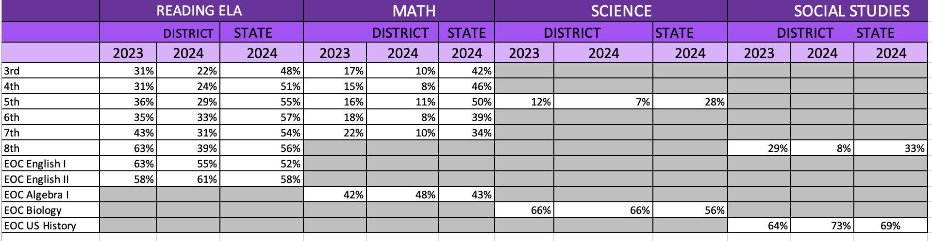
2023 – 2024 TAPR STAAR/EOC DISTRICT Performance
RCISD compared to the state at the meets level

Slide 12
2023 -2024 BILLINGUAL/ENGLISH AS A SECOND LANGUAGE
(CURRENT EB/EL STUDENTS)
DATA SHOWN IS ALL GRADES/ALL SUBJECTS AT MEETS GRADE LEVEL
PAGE 14 TAPR

Slide 13
BILINGUAL/ESL – CURRENT EB/EL STUDENTS
COMPARED TO THE STATE AND REGION IN READING AND MATH 2024
54
PAGE 14 TAPR

Slide 14
ATTENDANCE RATE
TAPR PAGE 19

Slide 15
4 YEAR GRADUATION RATE: CLASS OF 2023
94
98
90
3
0.3
4
TAPR PG. 19

Slide 16
2023 – 2024 Graduate profile
Total graduates
By ethnicity
By graduation type

Slide 17
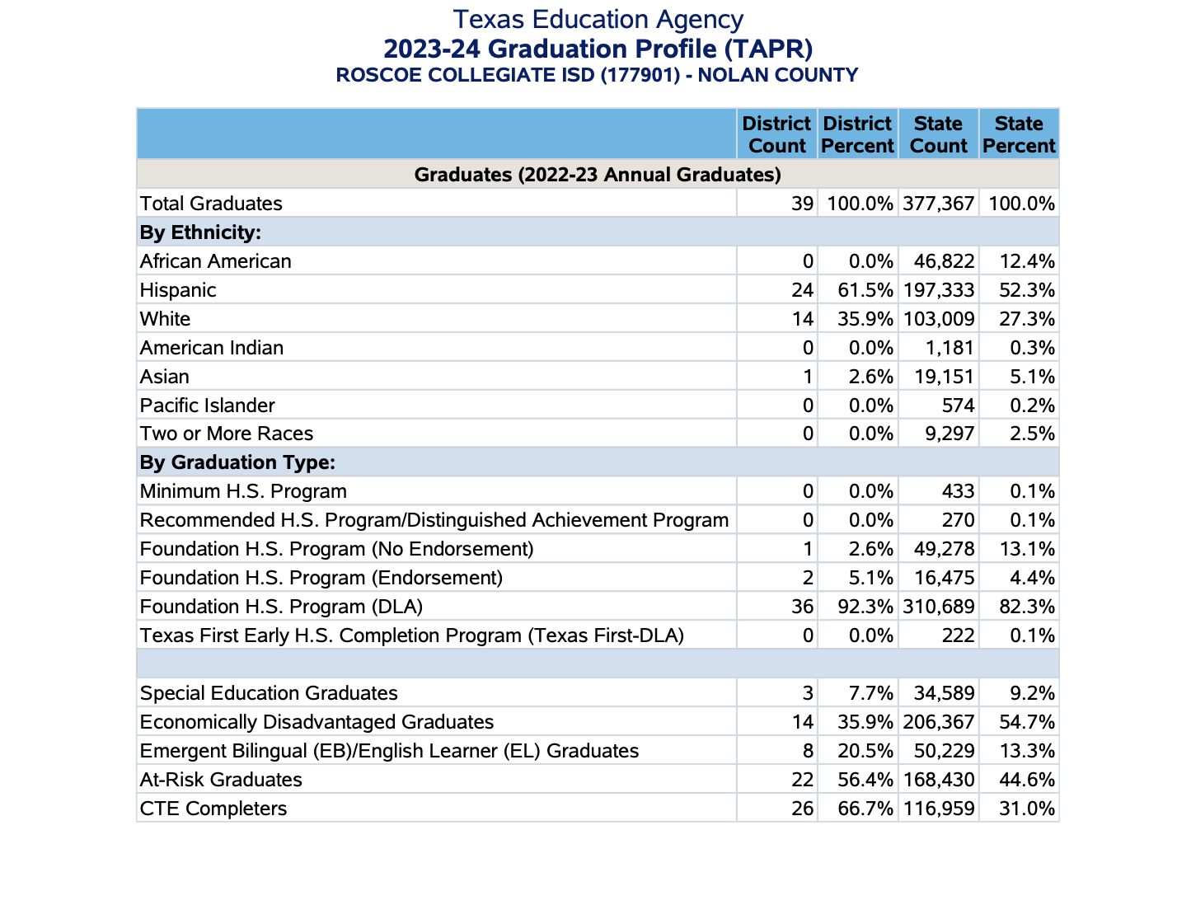
TAPR PAGE 22

Slide 18
COLLEGE, CAREER, AND MILITARY READY GRADUATES:
CLASS OF 2023
TAPR PAGE 22

Slide 19
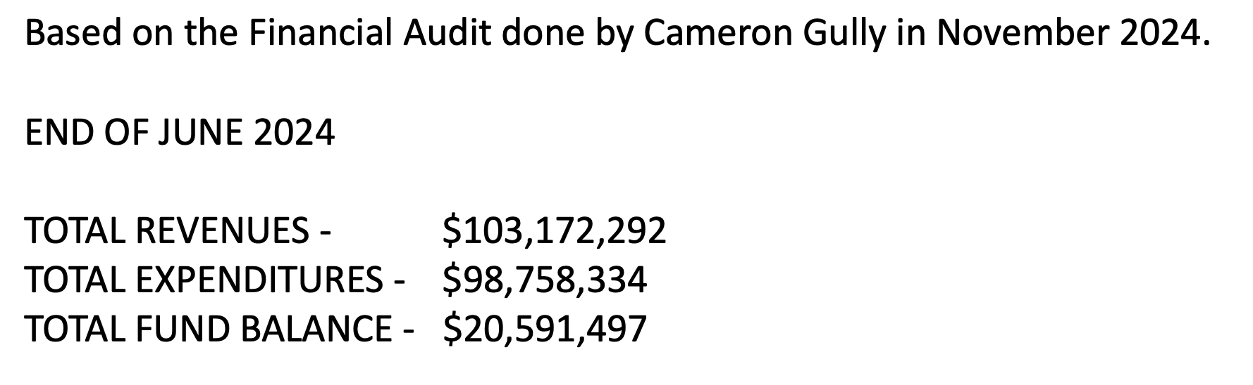
PEIMS FINANCIAL STANDARD REPORTS
As of February 2025– the state has not released actual Financial Reports
EXIBIT C-3 ANNUAL FINANCIAL AND COMPLIANCE REPORT

Slide 20
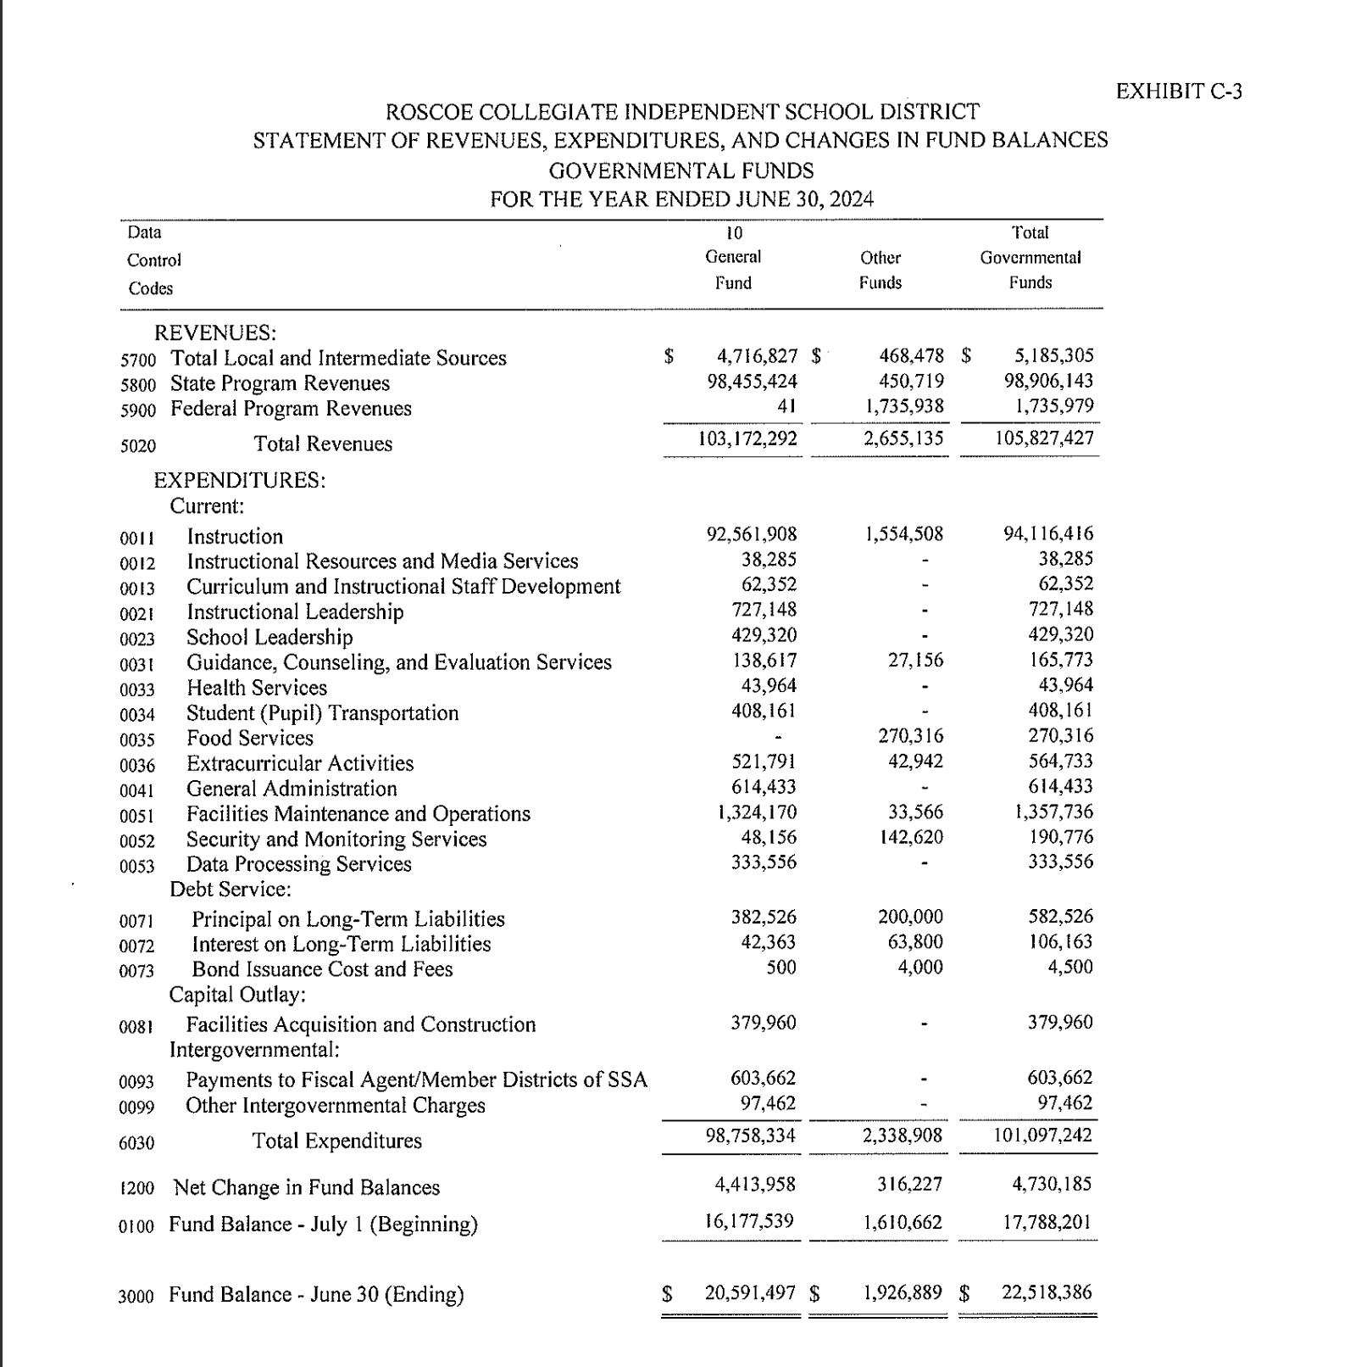

Slide 21
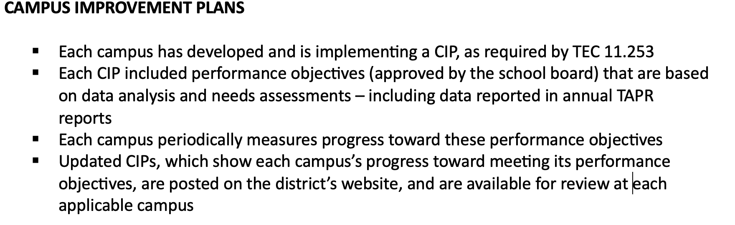
CAMPUS PERFORMANCE OBJECTIVES

Slide 22
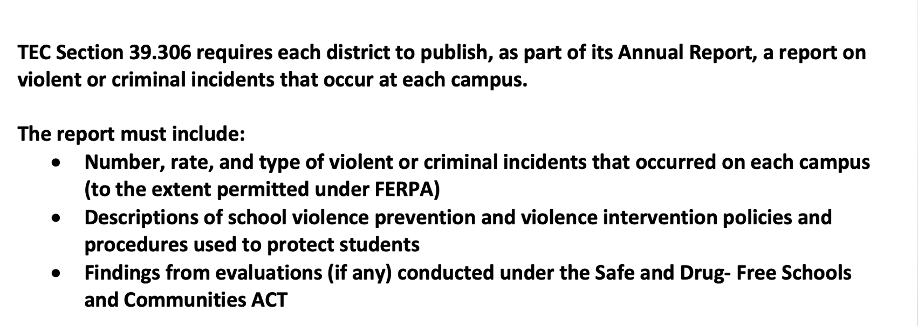
Violent or criminal incidents
** The district’s report is available for review at each campus and at central office.

Slide 23
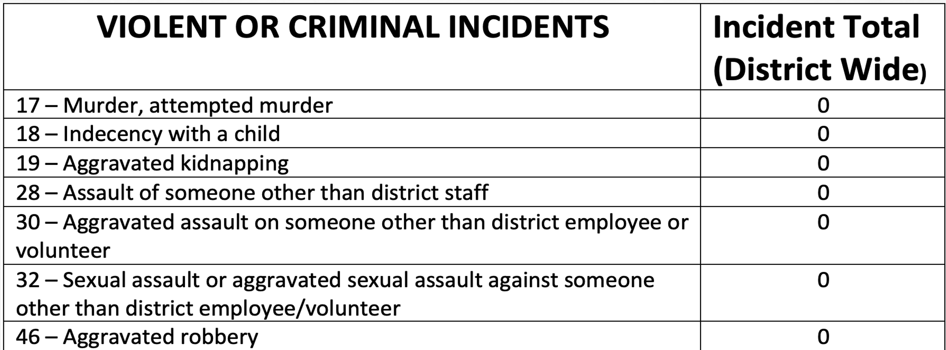

Slide 24
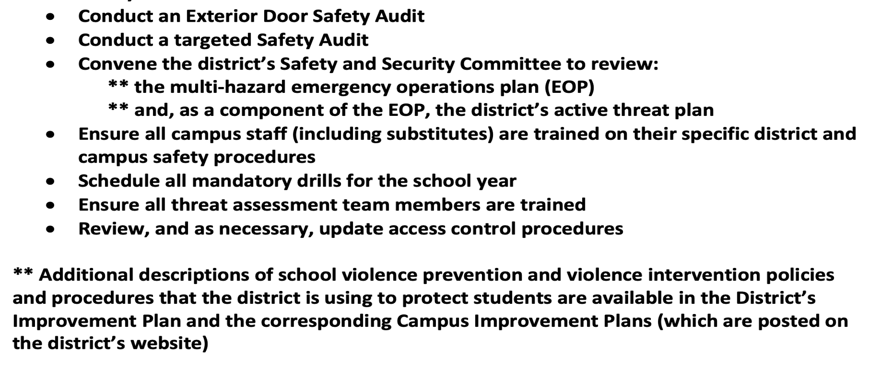
As required by TEA, the RCISD has taken the following steps prior to the start of the 2024 – 2025 school year:

Slide 25
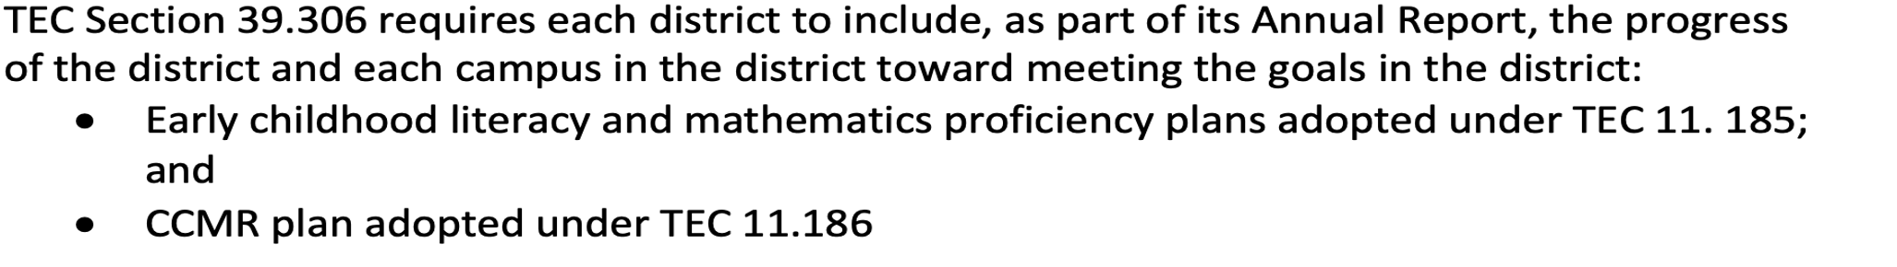
HB3 Early Childhood Literacy, mathematics, and ccmr board plan and goals
The progress made by RCISD and each campus is reported to the board each month. These goals are also posted on the RCISD website.

Slide 26
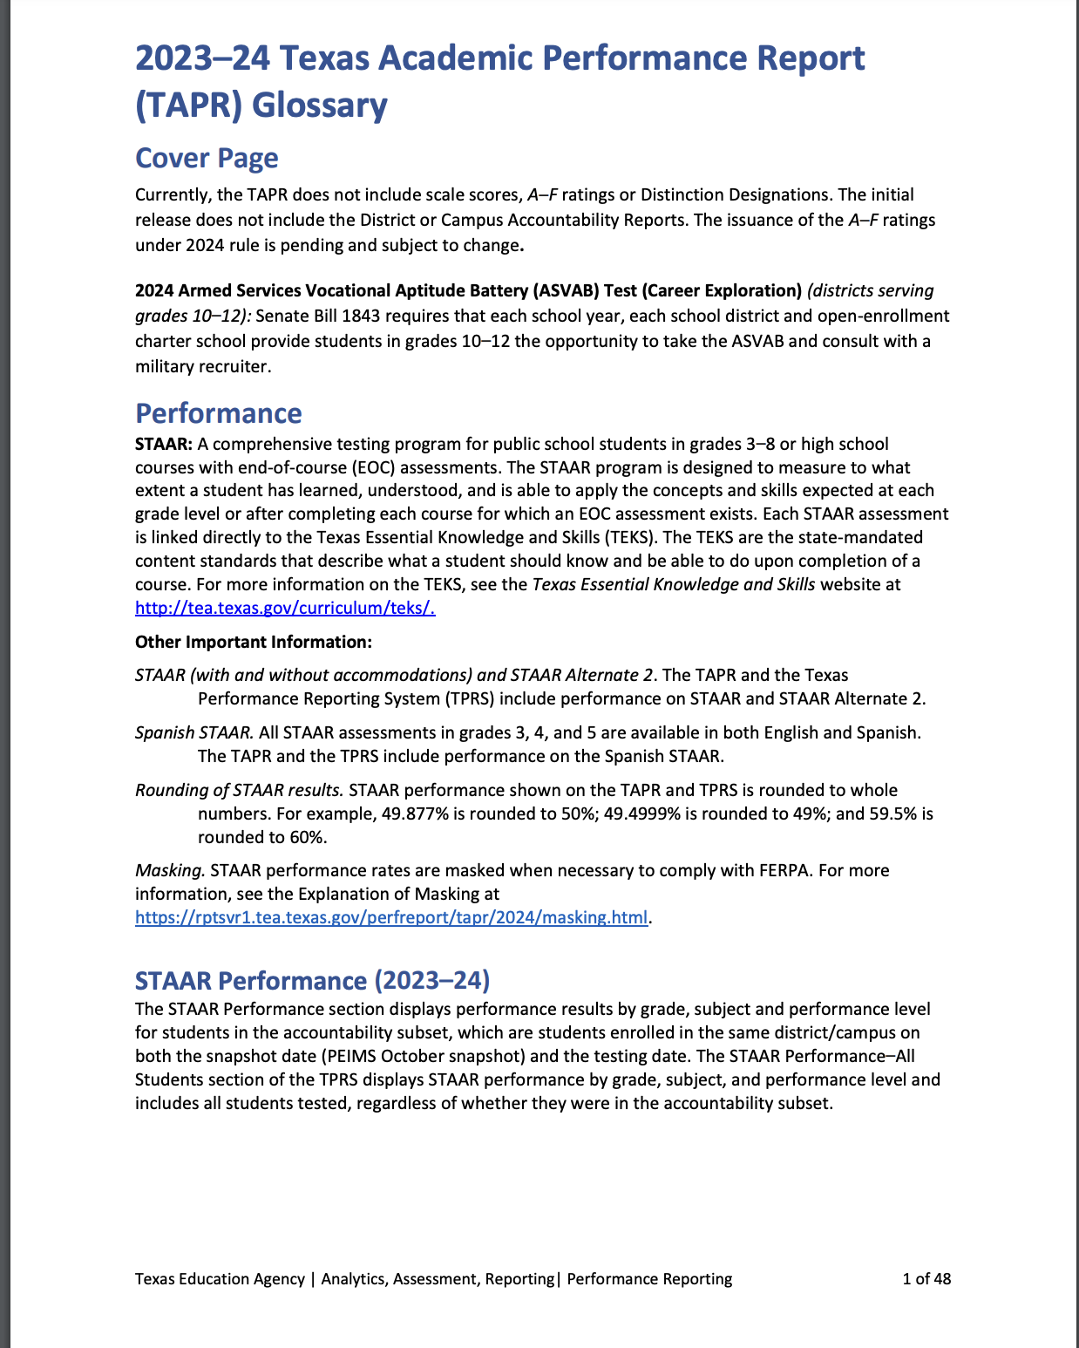
Tapr glossary
Link:
TAPR Glossary
TAPR Glossary- TEA Website

Slide 27
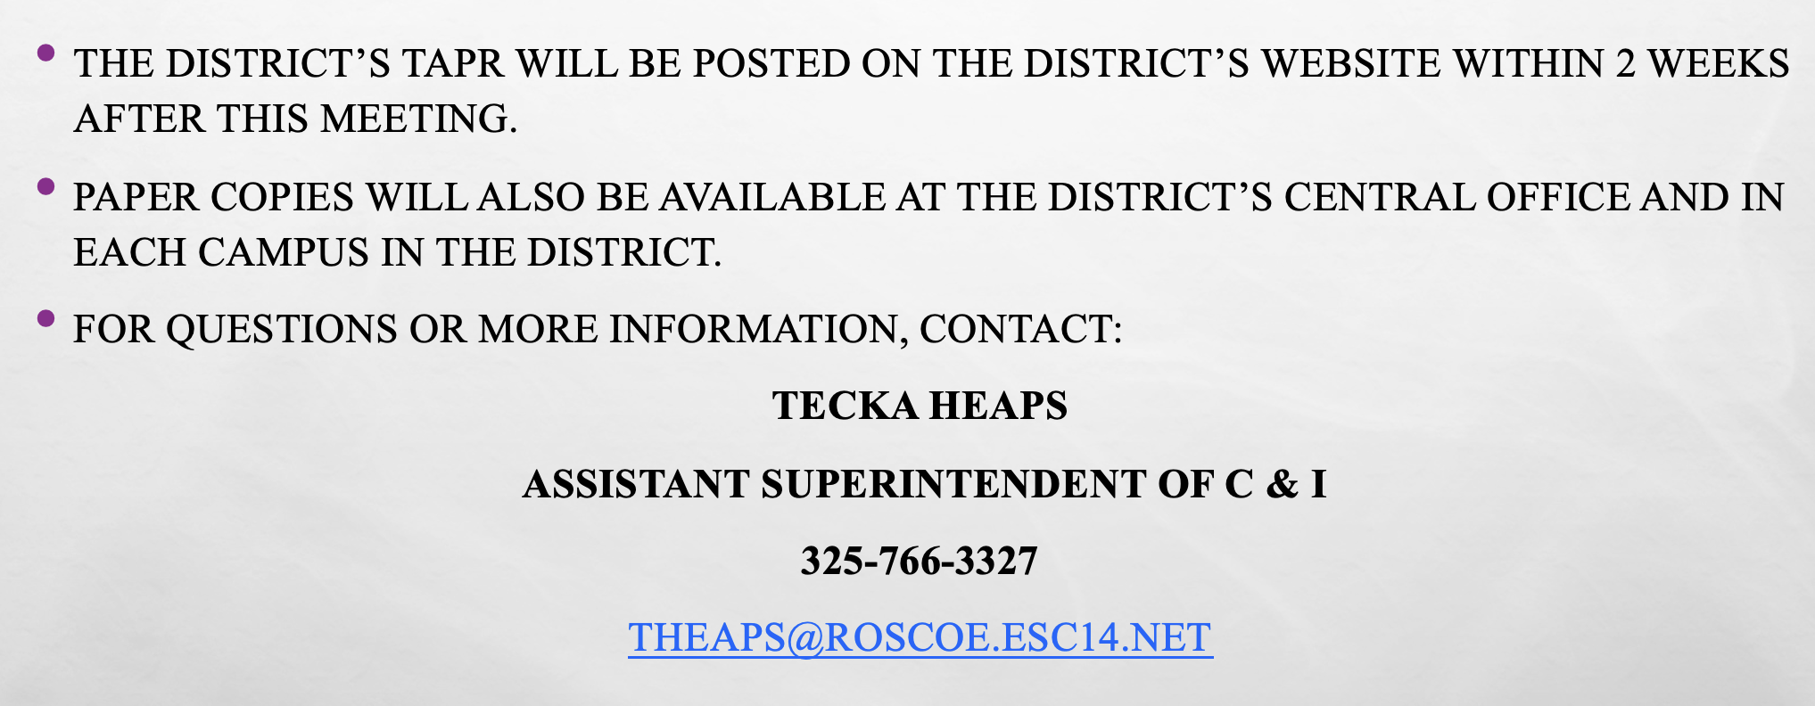
Resources and availability of Report

