Slide 1
Roscoe Collegiate I.S.d.
2024 – 2025 District Annual Report
PUBLIC HEARING
March 23 , 2026

Slide 2
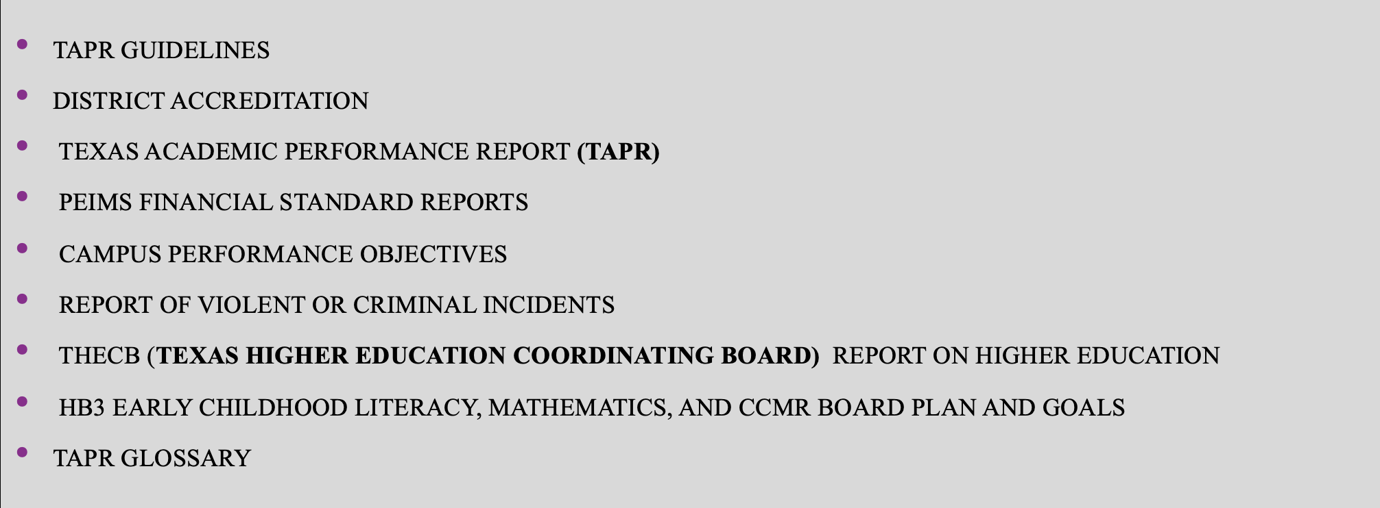
Components of the Annual Report

Slide 3
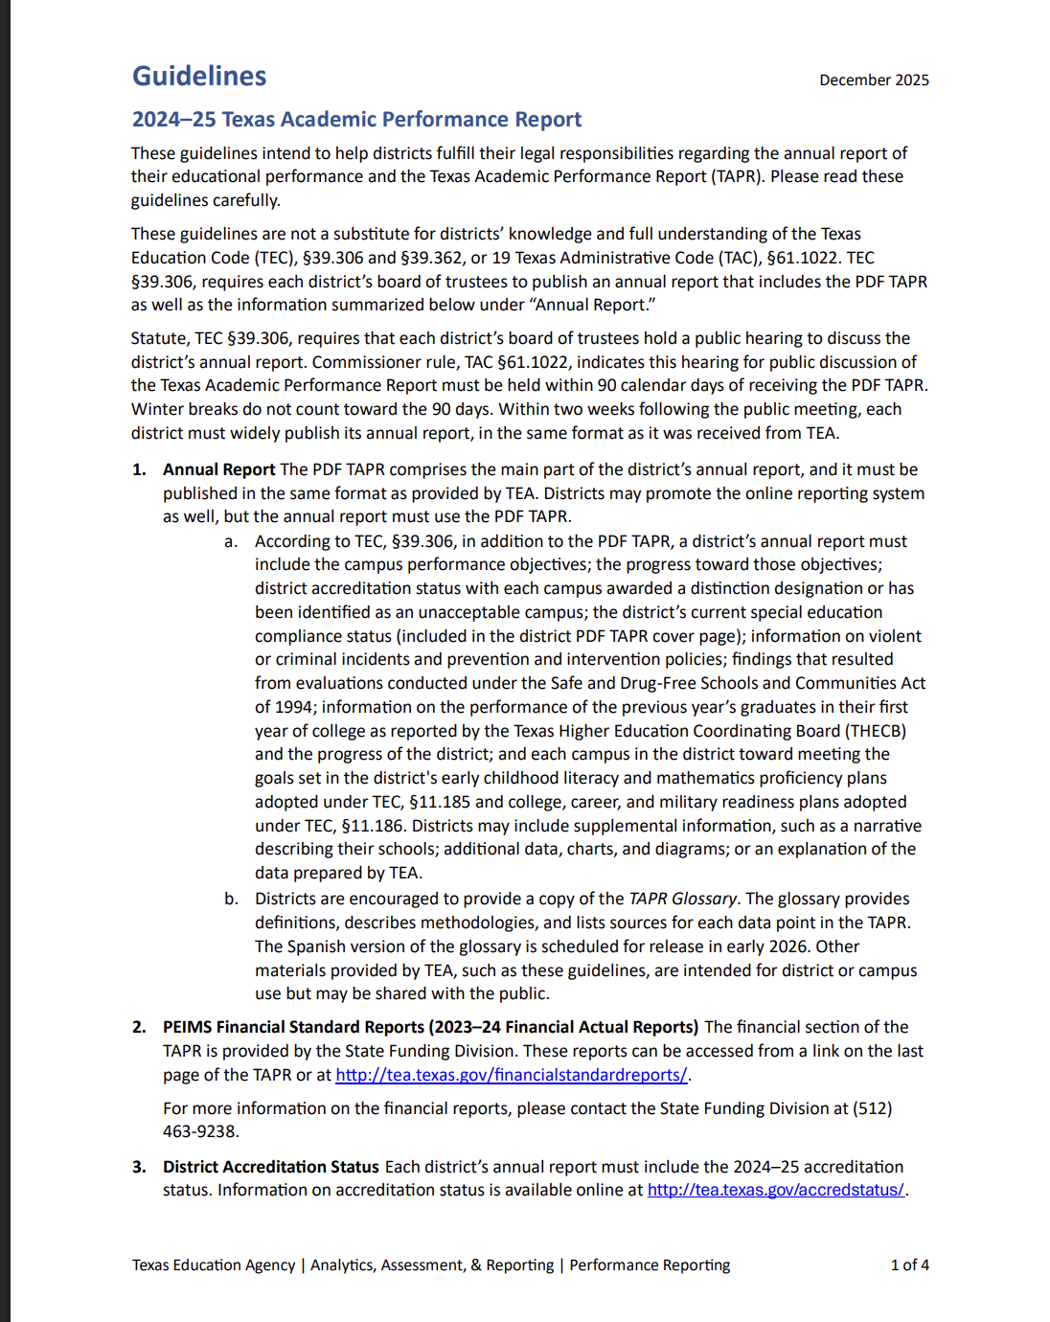
TAPR Guidelines
Link to TAPR Guidelines
TAPR Guidelines

Slide 4
2024-2025 District Accreditation status
2024-2025 First Rating: A Superior achievement
* 2025-2026 First Rating: B Above standard Achievement
2024 - 2025 Accountability rating: F
2024- 2025 accreditation status: accredited Warned
* 2025-2026 Accreditation Status: Accredited probation
2025 special education determination status: Needs Substantial Intervention

Slide 5
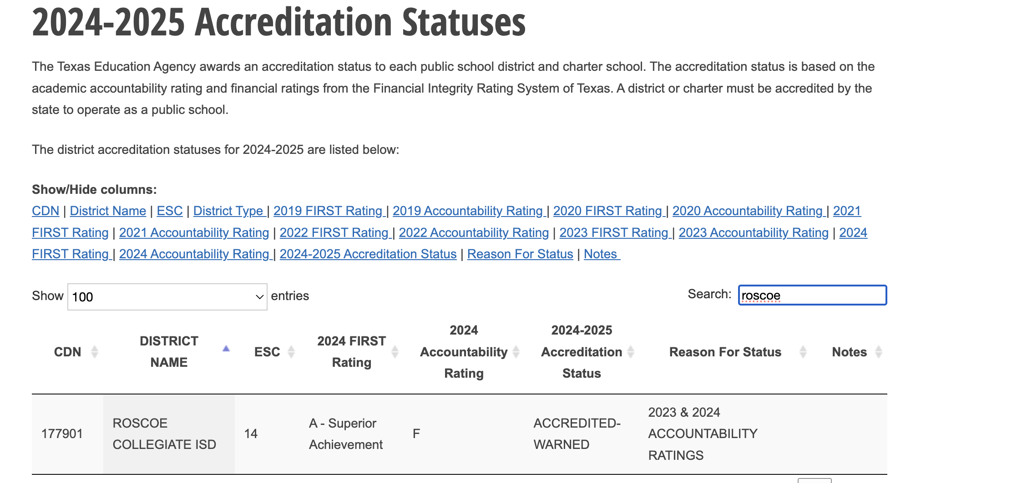

Slide 6
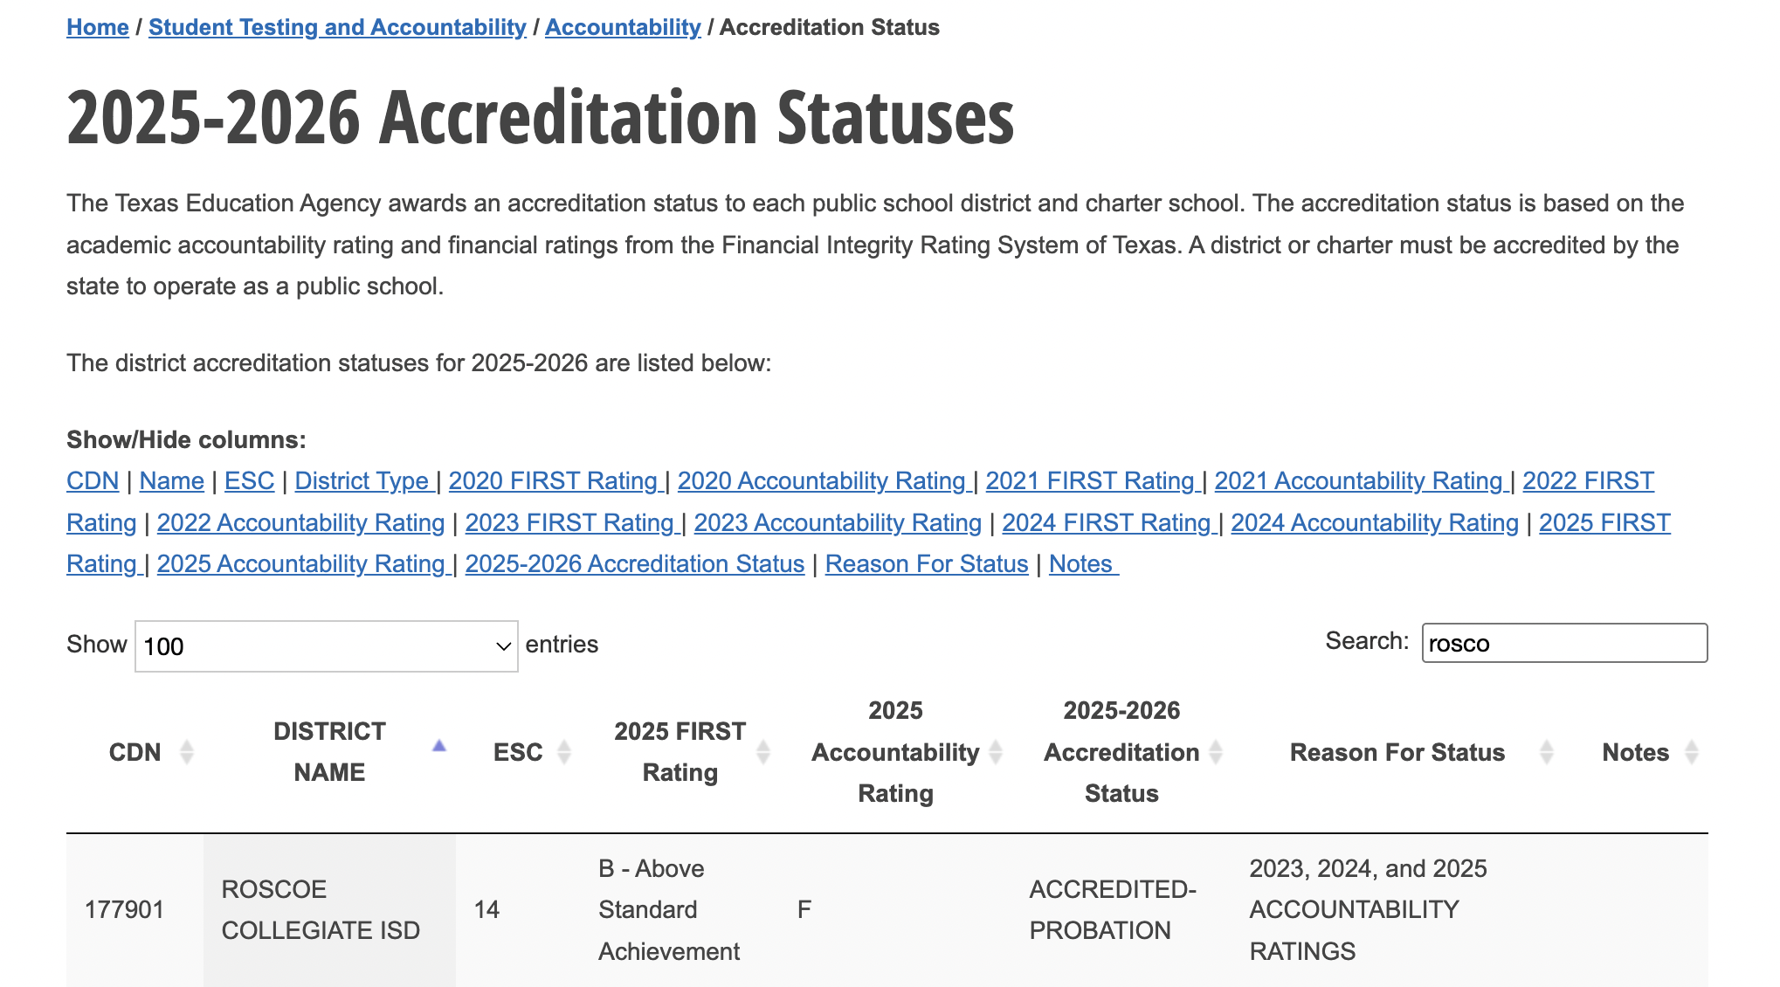

Slide 7
2024 – 2025 TEXAS ACADEMIC PERFORMANCE REPORT (TAPR)

Slide 8
Link to 2024-2025 TAPR
District TAPR

Slide 9
ALL GRADES/ALL SUBJECTS
2024 COMPARED TO 2025
42
17
4
4

Slide 10
ALL GRADES/BY SUBJECT
2024 COMPARED TO 2025 AT THE MEETS GRADE LEVEL
27
27
10
9
11

Slide 11
2024 – 2025 PERCENTAGE OF STUDENTS AT MEETS GRADE LEVEL STANDARD COMPARED TO THE STATE AND REGION BY SUBJECT
54
52
47
50
47
45
37
27
11
11

Slide 12
2024 – 2025 BILINGUAL/ENGLISH AS A SECOND LANGUAGE
CURRENT EB/EL STUDENTS
DATA SHOWN IS ALL GRADES/ALL SUBJECTS AT MEETS GRADE LEVEL
48
50
46
45
17

Slide 13
BILINGUAL/ESL – CURRENT EB/EL STUDENTS
COMPARED TO THE STATE AND REGION IN READING AND MATH
54
52
45
37
27
9

Slide 14
ATTENDANCE RATE
100
96
94
95
95
93

Slide 15
4 YEAR GRADUATION RATE: CLASS OF 2024
91
94
98
6
5
1
0
2.2

Slide 16
2024 – 2025 Graduate profile
Total graduates
By ethnicity
By graduation type

Slide 17
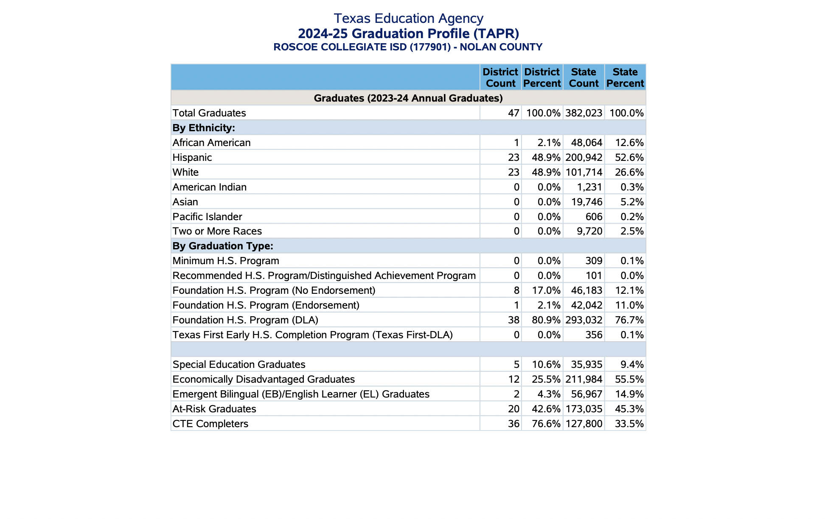

Slide 18
College, career, and military ready graduates: class of 2024
97
94
76
82
73
78

Slide 19
PEIMS FINANCIAL STANDARD REPORT
AS OF MARCH 2026 THE STATE HAS NOT RELEASED
ACTUAL FINANCIAL REPORTS
BASED ON THE FINANCIAL AUDIT
END OF JUNE 2025
TOTAL REVENUES - $160,288,122
TOTAL EXPENDITURES - $147,870,136
TOTAL FUND BALANCE -$33,462,897

Slide 20
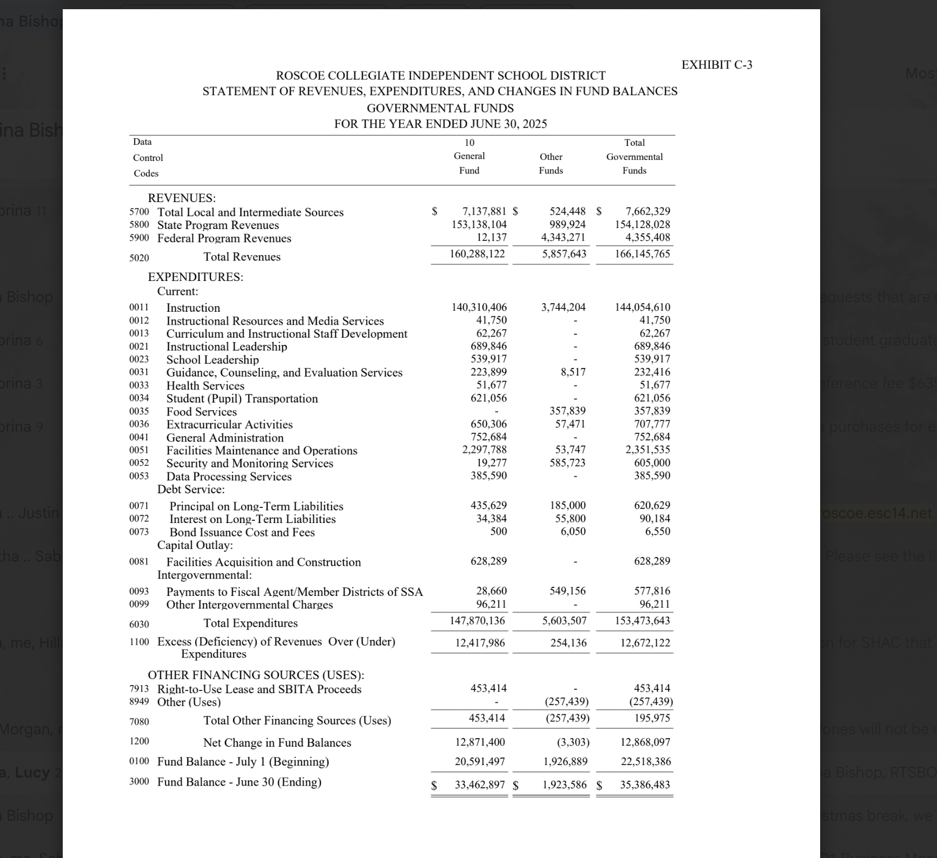
EXIBIT C-3 ANNUAL FINANCIAL AND COMPLIANCE REPORT

Slide 21
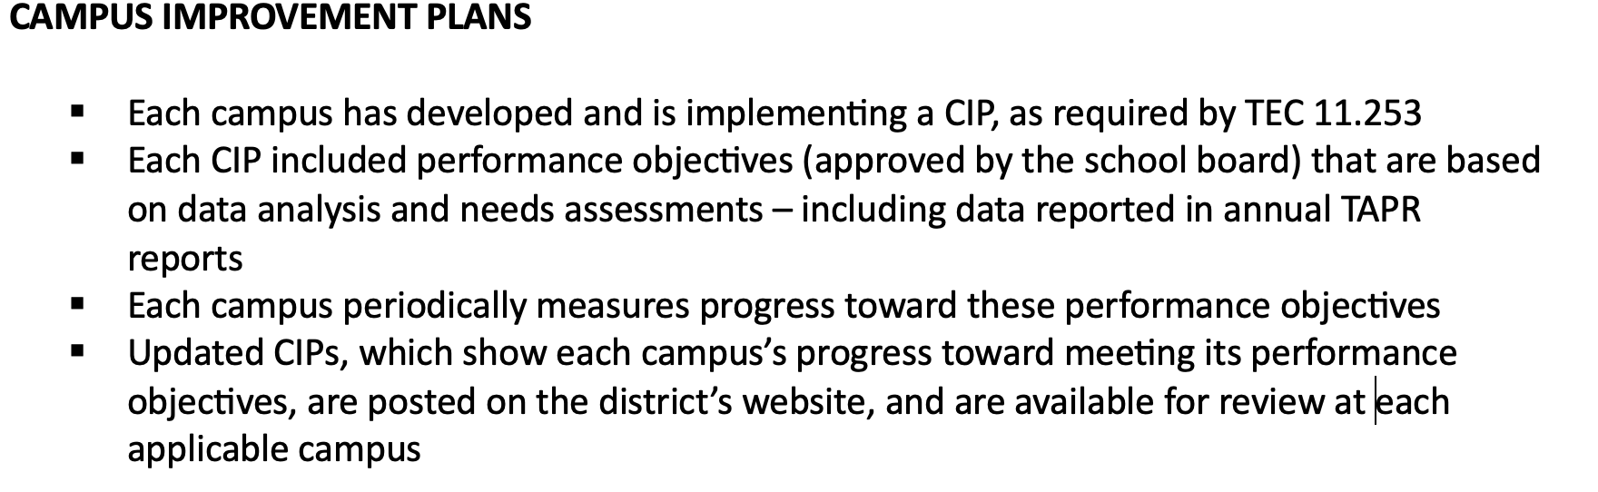
CAMPUS PERFORMANCE OBJECTIVES

Slide 22
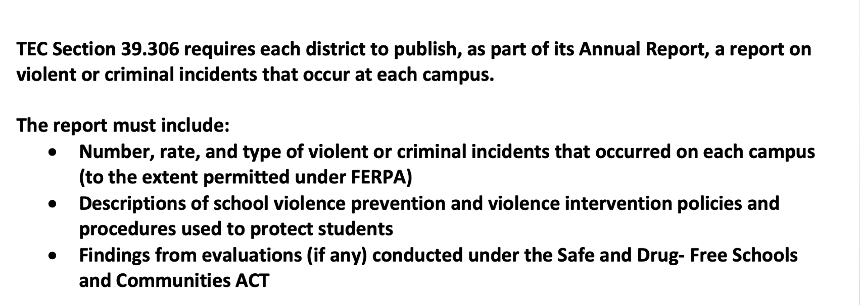
Violent or criminal incidents
** The district’s report is available for review at each campus and at central office.

Slide 23
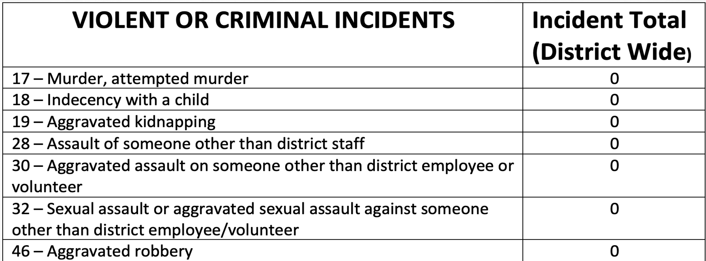

Slide 24
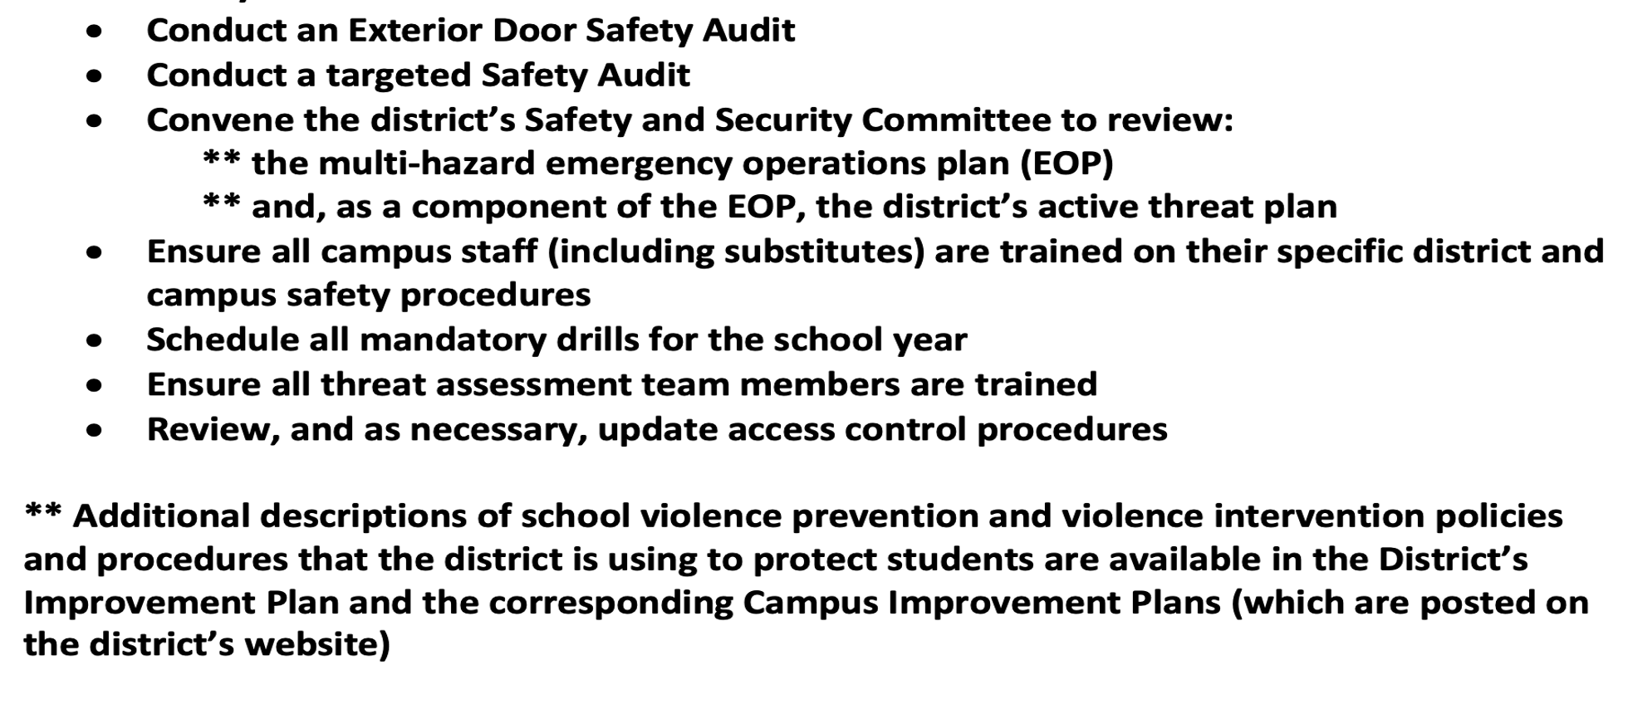
As required by TEA, the RCISD has taken the following steps prior to the start of the 2025 – 2026 school year:

Slide 25
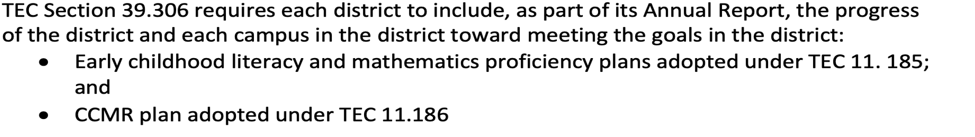
HB3 Early Childhood Literacy, mathematics, and ccmr board plan and goals
The progress made by RCISD and each campus is reported to the board each month. These goals are also posted on the RCISD website.

Slide 26
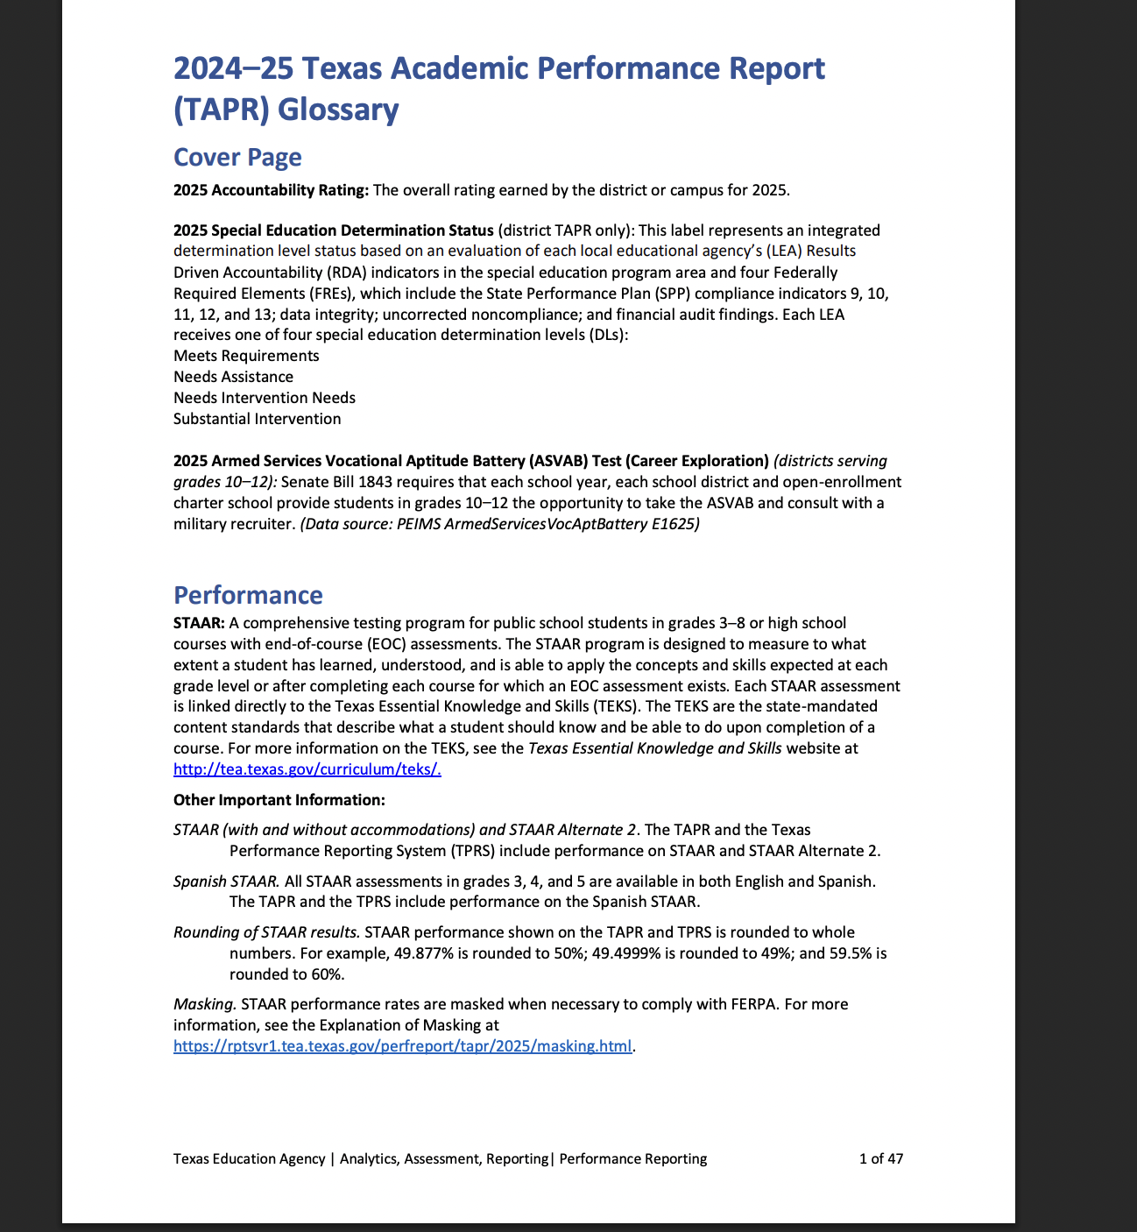
Tapr glossary
Link:
TAPR Glossary
TAPR Glossary- TEA Website

Slide 27
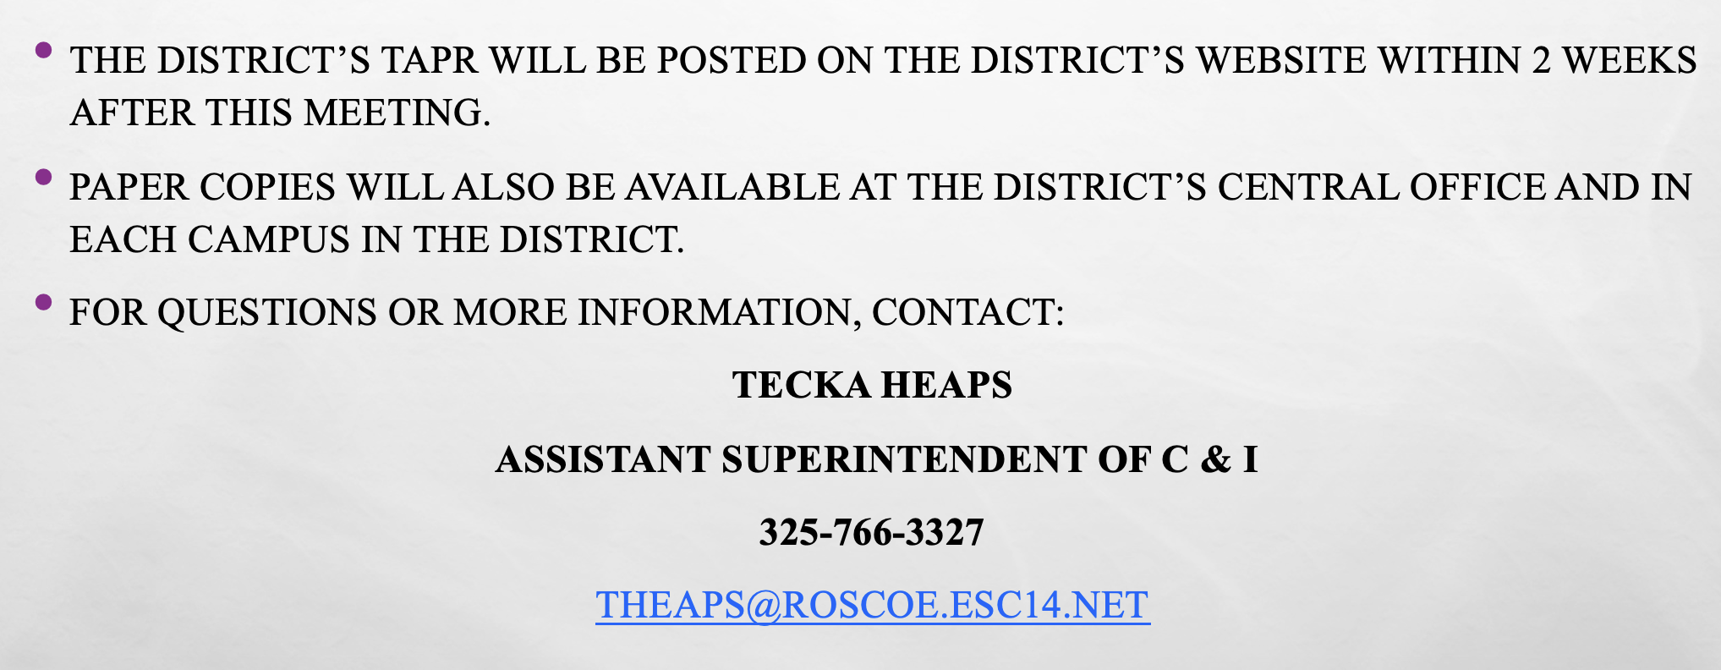
Resources and availability of Report

