Slide 1
Welcome
Meet the Teacher 2021

Slide 2
Introductions

Slide 3
Mr. Wilson

Slide 4
Teachers and Staff

Slide 5
Title I Meeting

Slide 6
ROSCOE CISD ANNUAL MEETING OF TITLE I, PART A FALL 2021

Slide 7
Why are we here?
The Elementary and Secondary School Act, Title I, Part A, requires that each Title I school hold an annual meeting for the parents and families whose children receive Title I services:
Informing you of the school’s participation in Title I, Part A
Explaining the requirements of Title I, Part A
Explaining your rights and opportunities as parents and families to be involved in your child’s learning and achievement.

Slide 8
What you will learn…
What it means to be a Title I, Part A School
The Campus Improvement Plan (CIP) and Title I plan
The School Parental Involvement Policy and the School Parent Compact
How to request information about the qualifications of my child’s teachers

Slide 9
What you will learn cont’d
How and when parents and families will be notified if their child is taught by a teacher who is not certified in a content area
How and when the annual evaluation of the parent and family engagement policy and program will be conducted
The ways in which parents and families can be involved to partner with the school to share the responsibility for improved student academic achievement

Slide 10
What is the purpose of Title I, PART A?
To ensure that all children have a fair, equal, and significant opportunity to obtain a high quality education and reach, at a minimum, proficiency on the TEKS (Texas Essential Knowledge and SKILLS), and on STAAR (State of Texas Assessment of Academic Readiness).

Slide 11
What is schoolwide Title I?
The Every Student Succeeds Act (ESSA) allows a school to be designated as a schoolwide Title I, Part A campus if 50 percent or more of the students come from low income families.

Slide 12
How does this help my child?
Our Elementary/ Early Childhood campuses are designated as a Schoolwide Title I Campus. In Title I, Part A schoolwide programs, funds can be used throughout the school to assist in the entire educational program as long as the school meets the needs of the students who are at risk of failing in school. These dollars are being used for:
Identifying students experiencing academic difficulties and providing timely assistance to help these students meet the State’s challenging content standards.
Specifically, Title I, Part A funds at Roscoe Elementary in the 2021 – 2022 school year are being used to: provide reading and math intervention, and to provide coaching in instructional strategies and in data analysis to our teachers.

Slide 13
Campus Improvement Plan
The school’s Campus Improvement Plan (CIP) include:
A needs assessment and summary of data
Goals, objectives, and strategies to address the academic needs of students
Professional development needs
Coordination of resources and services
Identification of Title I, Part A funds and expenditures
Strategies from the school’s parental involvement policy
Title I parents have the right to be involved in the development of the CIP

Slide 14
Parent and family Engagement plan
The policy addresses how the school will implement the parent and family engagement program. The policy includes:
Convene an annual meeting – MAY OF EACH YEAR
Provide flexible number of meetings
Involve parents in an organized, ongoing, and timely way, in the planning, review, and improvement of the parent and family engagement plan
Provide timely information about parent and family engagement activities
Provide information to parents about curriculum and assessment
If requested, provide additional meetings with parents to discuss decisions for the education of their child
Title I parents have the right to be involved in the development of the school policy
Communication is a two- way street: Phone calls, texts, emails, Grade Book parent portal, Montessori Compass, Folders/binders/planners, and the weekly news letter
Copies of the Parent and Family Engagement Plan can be found in the Student Handbook, Elementary website, and a hard copy is available on request.

Slide 15
School Parent Compact
The school – parent compact is a written agreement…
That addresses high- quality curriculum and instruction
That describes how parents and families, school staff, and students share the responsibility for improved student academic achievement
That stresses the importance of frequent communication between school and home, and the value of parent – teacher conferences (required in elementary school)
That affirms the importance of parents and families in decisions relating to the education of their children
Title I parents have the right to be involved in the development of the school parent compact
Copies of the Student/Teacher/Parent compact can be found in the Student Handbook, Elementary website, or through a hard copy on request.

Slide 16
Teacher Qualifications
Schools are required to notify parents that they have the right to request information regarding the qualifications of their child’s teacher
Parents must follow the school procedure to request this information
Check with the school office or district office to make this request

Slide 17
Annual evaluation
The content and effectiveness of the parental involvement policy and program must be evaluated annually – We do this in May of each year.
Identify barriers to participation in parental involvement
Data and input might include…
Parent questionnaires and surveys
Parent advisory committee input
Focus groups
These findings are reported to the parents and families and are used to revise the parental involvement policy and school- parent compacts. Changes are made and approved by our Campus Site Base Team.

Slide 18
Who Do I contact?
Tecka Heaps
Elementary Principal/Title I Coordinator
(325) 766-3323 Ext. 2108
theaps@roscoe.esc14.net

Slide 19
QUESTIONS?

Slide 20
THIS YEAR’S THEME:
SKY’S THE LIMIT

Slide 21
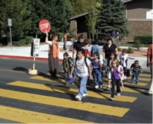
Other…
Cafeteria
Medications – Nurse
Sign up
After school safety

Slide 22
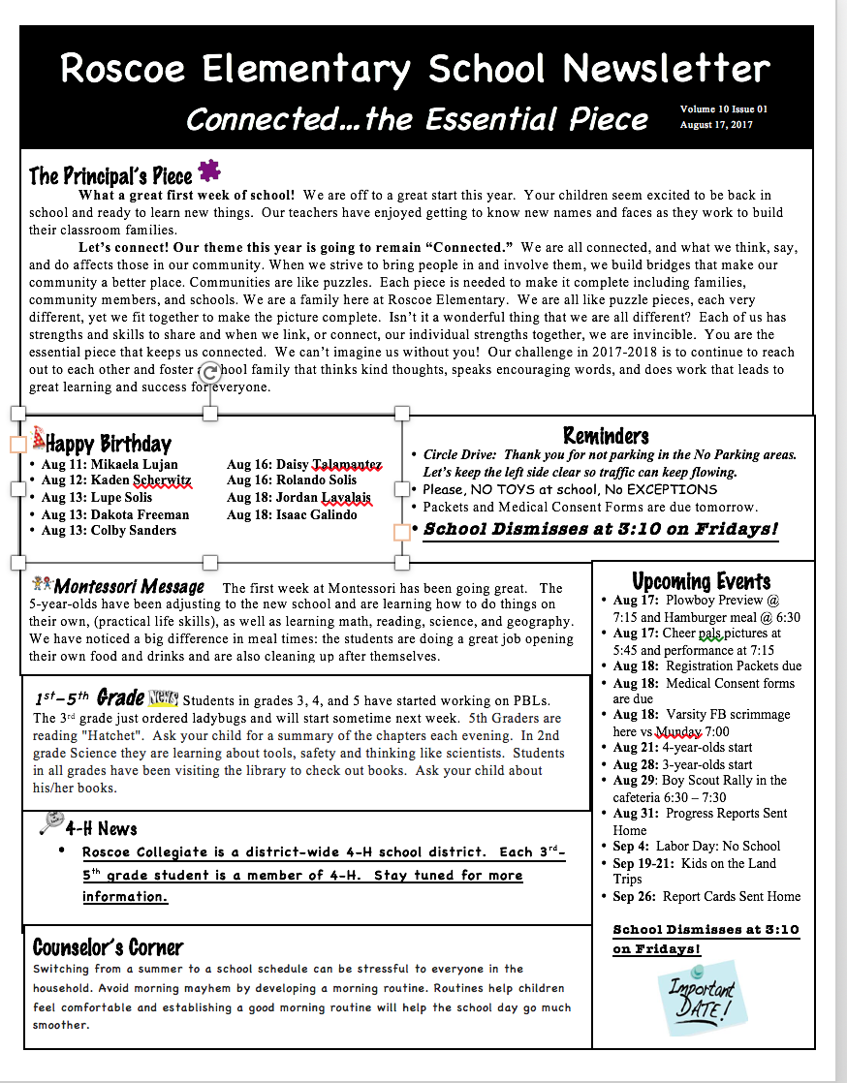
Connect…

Slide 23
Get involved…
Fall Festival is Oct. 8TH – Planning meeting August 25TH@4:15
Book Fair (Fall and Spring)
Thanksgiving meal
Muffins with Moms Info to come
Donuts with Dads
Literacy Night
Track Meet

Slide 24
Looking forward to
an awesome year!

Slide 25
MEET THE TEACHER

