Slide 1
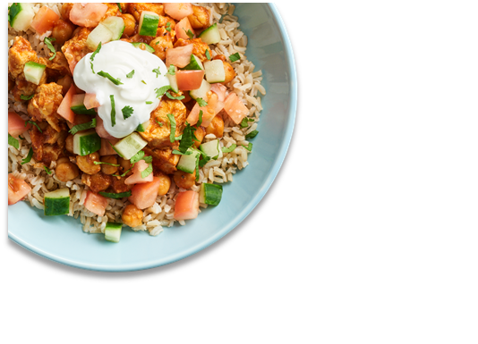




District Logo
January 2024
ROSCOE ISD MENU
 | MON |  | TUES |  | WED |  | THURS |  | FRI
1 |  | 2 |  | 3 |  | 4 |  | 5
8 |  | 9 |  | 10 |  | 11 |  | 12
15 |  | 16 |  | 17 |  | 18 |  | 19
22 |  | 23 |  | 24 |  | 25 |  | 26
29 |  | 30 |  | 31
HOLIDAY
HOLIDAY
HOLIDAY
HOLIDAY
HOLIDAY
Breakfast ​
FREE for all grades!​
$3.00 for ​
adult/staff​
​
Lunch
is $2.50 for
students​
$4.75 for​
adults/st​aff
HOLIDAY
French Toast Sticks
Pancake on Stick
Cereal/Side
BBQ Pork SDW
Beef & Cheese Burrito
Sausage Biscuit
Yogurt/Toast
Cereal/Side
Chicken Alfredo/Garlic Toast
Grilled Cheese
Chocolate Crescent
Breakfast Flatbread SDW
Cereal/Side
Spicy Chicken SDW
Nachos
PBJ
Sausage Pancake Bites
Breakfast Round
Cereal/Side
Chicken Tender/Breadstick
Pizza
HOLIDAY
Bosco Sticks
Cinnamon Roll
Cereal/Side
Chicken Tender/Breadstick
Hot Dog
Donut
Breakfast Taco
Cereal/Side
Cheeseburger
Turkey Wrap
Breakfast Pizza
Cocoa Pastry
Cereal/Side
Waffle/Sausage
Nachos
Scone
Pancake on a Stick
Cereal/Side
Meatball Sub
Pizza
Muffin/Side
Pancake on Stick
Cereal/Side
Chicken Tenders/Breadstick
Ham & Cheese Sub
Cheesy Egg Biscuit
Waffle
Cereal/Side
Enchilada Casserole/Rice
Maxx Sticks/Sauce
Sausage Egg Cheese Biscuit
Yogurt/Side
Cereal/Side
Plowboy Bowl/Roll
Spicy Chicken SDW
Donut
Pancake on Stick
Cereal/Side
Grilled Cheese
Nachos
Breakfast Round
Breakfast Flatbread SDW
Cereal/Side
Cheeseburger
Pizza
Cinnamon Biscuit
Pancake on Stick
Cereal/Side
Chicken Tenders/Breadstick
Chicken or Beef Burger
Breakfast Pizza
Muffin/Side
Cereal/Side
Chicken Alfredo/Garlic Toast
Cheese Quesadilla
Cheesy Egg Biscuit
Cinnamon Roll
Cereal/Side
Chicken & Veg Dumpling/Rice
All American Sub
Menus are subject to change.
All Lunches Must Include Choice of:
Fruits and/or
Vegetable
And May Include:
1% Low-Fat Milk
Salad/Roll & PBJ
are served Daily as a Meal!!!
Nachos Every Thursday!!!
This institution is an equal opportunity provider.

Slide 2
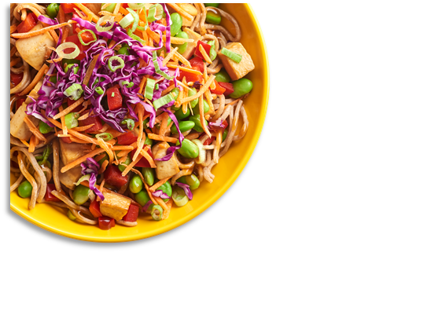



District Logo
February 2024
ROSCOE ISD MENU
 | MON |  | TUES |  | WED |  | THURS |  | FRI
 |  |  |  |  |  | 1 |  | 2
5 |  | 6 |  | 7 |  | 8 |  | 9
12 |  | 13 |  | 14 |  | 15 |  | 16
19 |  | 20 |  | 21 |  | 22 |  | 23
26 |  | 27 |  | 28 |  | 29
Muffin/Side
Cheesy Chicken Biscuit
Cereal/Side
Cheeseburger
Spicy Chicken SDW
French Toast Sticks/Sausage
Scone
Bosco Cheese Stick
Cereal/Side
Tater Tot Nachos/Roll
Pizza
Breakfast ​
FREE for all grades!​
$3.00 for ​
adult/staff​
​
Lunch
is $2.50 for
students​
$4.75 for​
adults/st​aff
Breakfast Pizza
Breakfast Round
Cereal/Side
Chili Dog
Chicken SDW
Donut Holes
Pancake on Stick
Cereal/Side
Enchilada Casserole/Rice
Beef Soft Taco
Muffin/Side
Breakfast Taco
Cereal/Side
Plowboy Bowl/Roll
Grilled Cheese SDW
Waffle
Yogurt/Toast
Cereal/Side
BBQ Chicken Flatbread SDW
Cheeseburger
Ham Egg Cheese Biscuit
Pancake on Stick
Cereal/Side
Cheesy Baked Penne
Pizza
Muffin/Side
Cheesy Egg Biscuit
Cereal/Side
BBQ Pork SDW
Chicken SDW
Sample:Thai Shrimp Noodle Bowl
French Toast Sticks
Pancake on Stick
Cereal/Side
Chicken Alfredo/Garlic Toast
Beef & Cheese Burrito
Sample:Thai Shrimp Noodle Bowl
Sausage Biscuit
Yogurt/Toast
Cereal/Side
Beef & Bean Tortilla Bowl
Grilled Cheese SDW
Chicken Alfredo/Garlic Toast
Sample:Thai Shrimp Noodle Bowl
Chocolate Crescent
Breakfast Flatbread SDW
Cereal/Side
Spicy Chicken SDW
Nachos
PBJ
Sample:Thai Shrimp Noodle Bowl
Sausage Pancake Bites
Breakfast Round
Cereal/Side
Chicken Tenders/Breadstick
Pizza
Sample:Thai Shrimp Noodle Bowl
CLOSED
Bosco Cheese Stick
Cinnamon Roll
Cereal/Side
Chicken Tenders/Breadstick
Hot Dog
Donut
Breakfast Taco
Cereal/Side
Cheeseburger
Turkey Wrap
Breakfast Pizza
Cocoa Pastry
Cereal/Side
Waffle/Sausage
Nachos
Scone
Pancake on Stick
Cereal/Side
Meatball Sub
Pizza
Muffin/Side
Pancake on Stick
Cereal/Side
Chicken Tenders/Breadstick
Ham & Cheese Sub
Cheesy Egg Biscuit
Waffle
Cereal/Side
Enchilada Casserole/Rice
Max Sticks/Sauce
Sausage Egg Cheese Biscuit
Yogurt/Side
Cereal/Side
Plowboy Bowl/Roll
Spicy Chicken SDW
Donut
Pancake on Stick
Cereal/Side
Grilled Cheese
Nachos
Menus are subject to change.
Salad/Roll & PBJ
are served Daily as a Meal!!!
Nachos Every Thursday!!!
Happy Valentines Day!!!!!
All Lunches Must Include Choice of:
Fruits and/or
Vegetable
And May Include:
1% Low-Fat Milk
This institution is an equal opportunity provider.

Slide 3
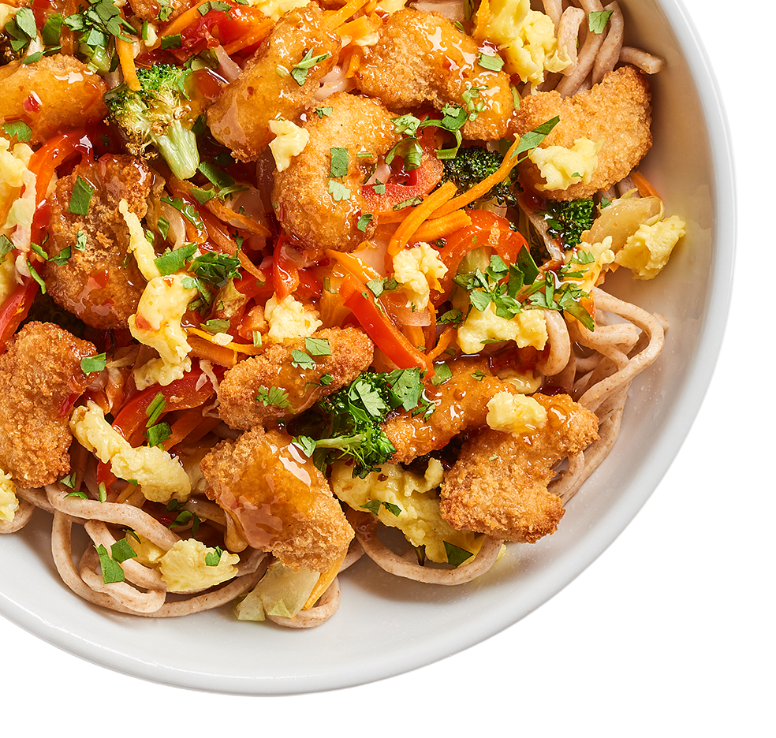


District Logo
March 2024
ROSCOE ISD MENU
 | MON |  | TUES |  | WED |  | THURS |  | FRI
 |  |  |  |  |  |  |  | 1
4 |  | 5 |  | 6 |  | 7 |  | 8
11 |  | 12 |  | 13 |  | 14 |  | 15
18 |  | 19 |  | 20 |  | 21 |  | 22
25 |  | 26 |  | 27 |  | 28 |  | 29
Breakfast Round
Breakfast Flatbread SDW
Cereal/Side
Cheeseburger
Pizza
Breakfast ​
FREE for all grades!​
$3.00 for ​
adult/staff​
​
Lunch
is $2.50 for
students​
$4.75 for​
adults/st​aff
Cinnamon Biscuit
Cereal/Side
Chicken Tenders/Breadstick
Cheeseburger or Chicken Burger
Breakfast Pizza
Cereal/Side
Chicken Alfredo/Garlic Toast
Spicy Chicken SDW
Cheesy Egg Biscuit
Cereal/Side
Cheeseburger
All American Sub
Muffin Top/Side
Cereal/Side
French Toast Sticks/Sausage
Nachos
National Cereal Day
Bosco Cheese Stick
Cereal/Side
Chicken Quesadilla
Pizza
HOLIDAY
HOLIDAY
HOLIDAY
HOLIDAY
HOLIDAY
Muffin/Side
Cereal/Side
BBQ Pork SDW
Chicken SDW
Sample:Spicy Chicken Mole Taco
French Toast Sticks
Cereal/Side
Chicken Tenders/Breadstick
Beef & Cheese Burrito
Sample:Spicy Chicken Mole Taco
Sausage Biscuit
Cereal/Side
Chicken Alfredo/Garlic Toast
Grilled Cheese
Sample:Spicy Chicken Mole Taco
Breakfast Flatbread SDW
Cereal/Side
Spicy Chicken SDW
Nachos
PBJ
Sample:Spicy Chicken Mole Taco
Breakfast Round
Cereal/Side
Beef Tortilla Rice Bowl/Churro
Pizza
Sample:Spicy Chicken Mole Taco
Cheesy Chicken Biscuit
Cereal/Side
Chicken SDW
Chicken Feta Wrap
Bosco Cheese Stick
Cereal/Side
Chicken Tenders/Breadstick
Hot Dog
Breakfast Taco
Cereal/Side
Cheeseburger
Turkey Wrap
Breakfast Pizza
Cereal/Side
Waffle/Sausage
Nachos
CLOSED
Menus are subject to change.
All Lunches Must Include Choice of:
Fruits and/or
Vegetable
And May Include:
1% Low-Fat Milk
Salad/Roll & PBJ
are served Daily as a Meal!!!
Nachos Every Thursday!!!
This institution is an equal opportunity provider.

Slide 4
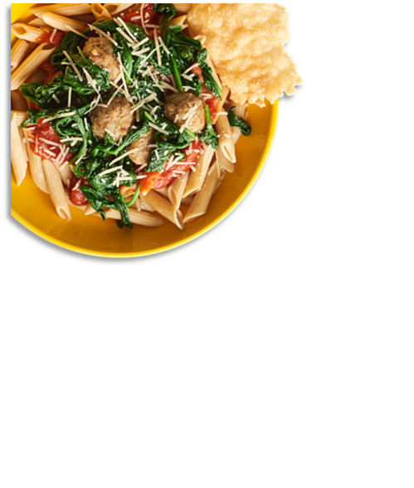


District Logo
April 2024
ROSCOE ISD MENU
 | MON |  | TUES |  | WED |  | THURS |  | FRI
1 |  | 2 |  | 3 |  | 4 |  | 5
8 |  | 9 |  | 10 |  | 11 |  | 12
15 |  | 16 |  | 17 |  | 18 |  | 19
22 |  | 23 |  | 24 |  | 25 |  | 26
29 |  | 30
Muffin/Side
Cereal/Side
Chicken Tenders/Breadstick
Ham & Cheese Sub
Waffle
Cereal/Side
Enchilada Casserole/Rice
Max Sticks/Sauce
Managers Choice
2 options
PBJ
Pancake on a Stick
Cereal/Side
Grilled Cheese
Nachos
Breakfast Flatbread SDW
Cereal/Side
Pizza
Cheeseburger
Breakfast ​
FREE for all grades!​
$3.00 for ​
adult/staff​
​
Lunch
is $2.50 for
students​
$4.75 for​
adults/st​aff
Cinnamon Biscuit
Cereal/Side
Chicken Tenders/Breadstick
Cheeseburger
Breakfast Pizza
Cereal/Side
Chicken Alfredo/Garlic Toast
Spicy Chicken SDW
Managers Choice
2 options
PBJ
Muffin Top/Side
Cereal/Side
French Toast Sticks/Sausage
Nachos
Bosco Cheese Stick
Cereal/Side
Pizza
Chicken Quesadilla
Breakfast Round
Cereal/Side
Hot Dog
Chicken SDW
Sample: Jal. Cheddar Burger
Pancake on a Stick
Cereal/Side
Enchilada Casserole/Rice
Beef Soft Taco
Sample: Jal. Cheddar Burger
Waffle
Cereal/Side
BBQ Chicken Flatbread SDW
Nachos
Sample: Jal. Cheddar Burger
Ham Egg Cheese Biscuit
Cereal/Side
Pizza
Cheesy Baked Penne
Sample: Jal. Cheddar Burger
Managers Choice
2 options
PBJ
Sample: Jal. Cheddar Burger
Muffin/Side
Cereal/Side
BBQ Pork SDW
Chicken SDW
French Toast Sticks
Cereal/Side
Beef & Cheese Burrito
Chicken Tenders/Breadstick
Managers Choice
2 options
PBJ
Breakfast Flatbread SDW
Cereal/Side
PBJ
Spicy Chicken SDW
Nachos
Breakfast Round
Cereal/Side
Pizza
Beef & Bean Tortilla Bowl/Churro
Cheesy Chicken Biscuit
Cereal/Side
Chicken SDW
Chicken Feta Wrap
Bosco Cheese Stick
Cereal/Side
Chicken Tenders/Breadstick
Hot Dog
Menus are subject to change.
All Lunches Must Include Choice of:
Fruits and/or
Vegetable
And May Include:
1% Low-Fat Milk
Salad/Roll & PBJ
are served Daily as a Meal!!!
Nachos Every Thursday!!!
This institution is an equal opportunity provider.

Slide 5
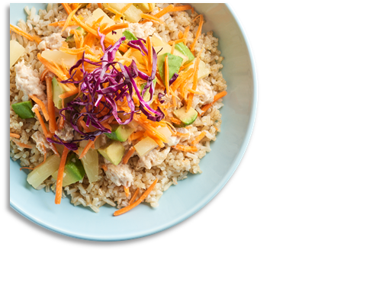



District Logo
May 2024
ROSCOE ISD MENU
 | MON |  | TUES |  | WED |  | THURS |  | FRI
 |  |  |  | 1 |  | 2 |  | 3
6 |  | 7 |  | 8 |  | 9 |  | 10
13 |  | 14 |  | 15 |  | 16 |  | 17
20 |  | 21 |  | 22 |  | 23 |  | 24
27 |  | 28 |  | 29 |  | 30 |  | 31
Breakfast Taco
Cereal/Side
Cheeseburger
Turkey Wrap
Breakfast Pizza
Cereal/Side
Waffle/Sausage
Nachos
Scone
Cereal/Side
Meatball Sub
Pizza
School Lunch Hero Day
Breakfast ​
FREE for all grades!​
$3.00 for ​
adult/staff​
​
Lunch
is $2.50 for
students​
$4.75 for​
adults/st​aff
Muffin/Side
Cereal/Side
Max Sticks/Sauce
Ham & Cheese Sub
Chicken Tenders/Breadstick
Cheesy Egg Biscuit
Waffle
Cereal/Side
Enchilada Casserole/Rice
Chicken Tenders/Breadstick
Strawberry Yogurt Parfait/Sides
Sausage Egg Cheese Biscuit
Cereal/Side
Plowboy Bowl/Roll
Spicy Chicken SDW
Pancake on Stick
Cereal/Side
Grilled Cheese
Nachos
CLOSED
Managers Choice
2 options
PBJ
Sample: Tropical Chicken Bowl
Managers Choice
2 options
PBJ
Sample: Tropical Chicken Bowl
Managers Choice
2 options
PBJ
Sample: Tropical Chicken Bowl
CLOSED
CLOSED
SUMMER BREAK
SUMMER BREAK
SUMMER BREAK
SUMMER BREAK
SUMMER BREAK
SUMMER BREAK
SUMMER BREAK
SUMMER BREAK
SUMMER BREAK
SUMMER BREAK
Menus are subject to change.
All Lunches Must Include Choice of:
Fruits and/or
Vegetable
And May Include:
1% Low-Fat Milk
Salad/Roll & PBJ
are served Daily as a Meal!!!
Nachos Every Thursday!!!
This institution is an equal opportunity provider.

Slide 6


District Logo
June 2024
ROSCOE ISD MENU
 | MON |  | TUES |  | WED |  | THURS |  | FRI
3 |  | 4 |  | 5 |  | 6 |  | 7
10 |  | 11 |  | 12 |  | 13 |  | 14
17 |  | 18 |  | 19 |  | 20 |  | 21
24 |  | 25 |  | 26 |  | 27 |  | 28
Menu Item
Menu Item
Menu Item
Menu Item
Menu Item
Menu Item
Menu Item
Menu Item
Menu Item
Menu Item
Menu Item
Menu Item
Menu Item
Menu Item
Menu Item
Breakfast ​
FREE for all grades!​
$3.00 for ​
adult/staff​
​
Lunch
is $2.50 for
students​
$4.75 for​
adults/st​aff
Menu Item
Menu Item
Menu Item
Menu Item
Menu Item
Menu Item
Menu Item
Menu Item
Menu Item
Menu Item
Menu Item
Menu Item
Menu Item
Menu Item
Menu Item
Menu Item
Menu Item
Menu Item
Menu Item
Menu Item
Menu Item
Menu Item
Menu Item
Menu Item
Menu Item
Menu Item
Menu Item
Menu Item
Menu Item
Menu Item
Menu Item
Menu Item
Menu Item
Menu Item
Menu Item
Menu Item
Menu Item
Menu Item
Menu Item
Menu Item
Menu Item
Menu Item
Menu Item
Menu Item
Menu Item
Menus are subject to change.
All Lunches Must Include Choice of:
Fruits and/or
Vegetable
And May Include:
1% Low-Fat Milk
Salad/Roll & PBJ
are served Daily as a Meal!!!
Nachos Every Thursday!!!
This institution is an equal opportunity provider.

Slide 7
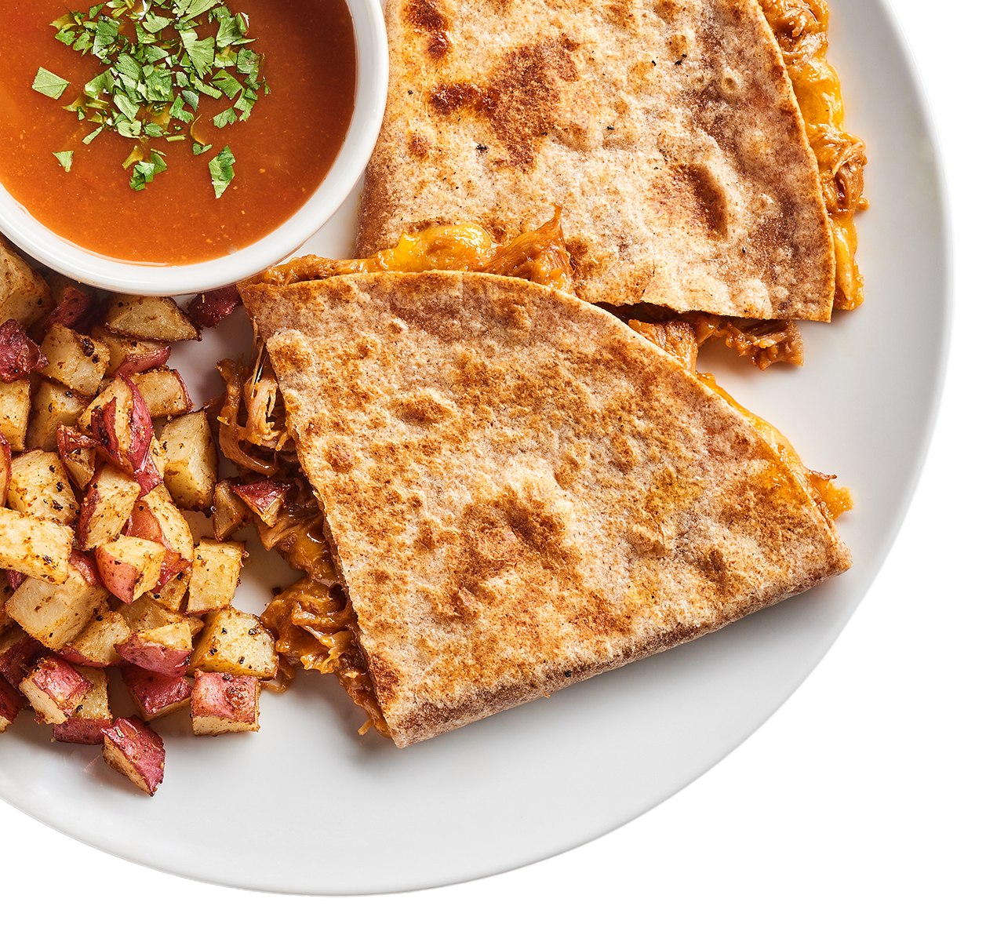

District Logo
July 2024
ROSCOE ISD MENU
 | MON |  | TUES |  | WED |  | THURS |  | FRI
1 |  | 2 |  | 3 |  | 4 |  | 5
8 |  | 9 |  | 10 |  | 11 |  | 12
15 |  | 16 |  | 17 |  | 18 |  | 19
22 |  | 23 |  | 24 |  | 25 |  | 26
29 |  | 30 |  | 31
Menu Item
Menu Item
Menu Item
Menu Item
Menu Item
Menu Item
Menu Item
Menu Item
Menu Item
Menu Item
Menu Item
Menu Item
Menu Item
Menu Item
Menu Item
Breakfast ​
FREE for all grades!​
$3.00 for ​
adult/staff​
​
Lunch
is $2.50 for
students​
$4.75 for​
adults/st​aff
Menu Item
Menu Item
Menu Item
Menu Item
Menu Item
Menu Item
Menu Item
Menu Item
Menu Item
Menu Item
Menu Item
Menu Item
Menu Item
Menu Item
Menu Item
Menu Item
Menu Item
Menu Item
Menu Item
Menu Item
Menu Item
Menu Item
Menu Item
Menu Item
Menu Item
Menu Item
Menu Item
Menu Item
Menu Item
Menu Item
Menu Item
Menu Item
Menu Item
Menu Item
Menu Item
Menu Item
Menu Item
Menu Item
Menu Item
Menu Item
Menu Item
Menu Item
Menu Item
Menu Item
Menu Item
Menu Item
Menu Item
Menu Item
Menu Item
Menu Item
Menu Item
Menu Item
Menu Item
Menu Item
Menus are subject to change.
All Lunches Must Include Choice of:
Fruits and/or
Vegetable
And May Include:
1% Low-Fat Milk
Salad/Roll & PBJ
are served Daily as a Meal!!!
Nachos Every Thursday!!!
This institution is an equal opportunity provider.

Slide 8
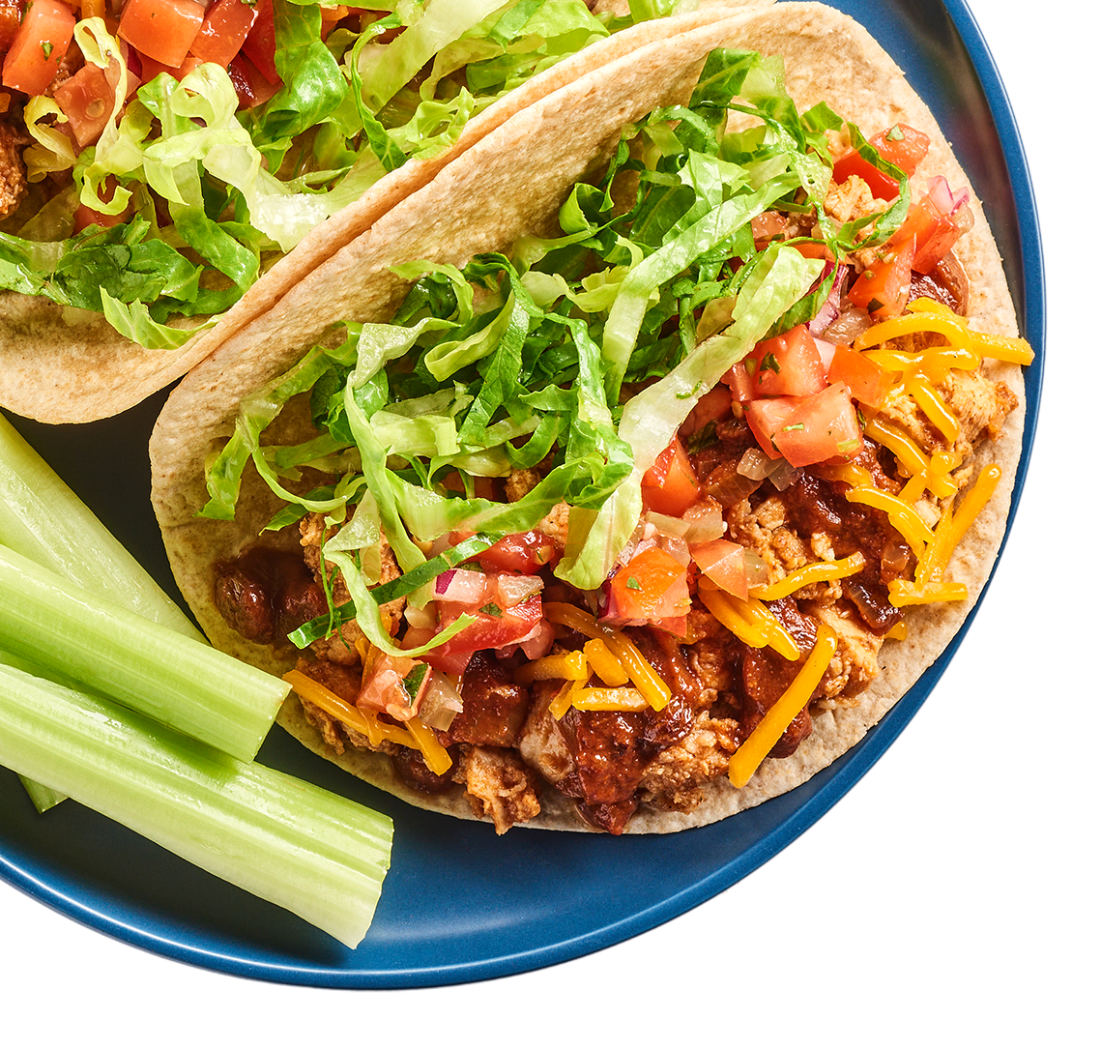
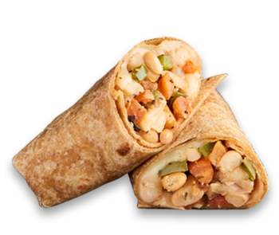
District Logo
August 2024
ROSCOE ISD MENU
 | MON |  | TUES |  | WED |  | THURS |  | FRI
 |  |  |  |  |  | 1 |  | 2
5 |  | 6 |  | 7 |  | 8 |  | 9
12 |  | 13 |  | 14 |  | 15 |  | 16
19 |  | 20 |  | 21 |  | 22 |  | 23
26 |  | 27 |  | 28 |  | 29 |  | 30
Breakfast ​
FREE for all grades!​
$3.00 for ​
adult/staff​
​
Lunch
is $2.60 for
students​
$5.00 for​
adults/st​aff
Staff Menu
Coffee Bar
Grade 9-12
SUMMER BREAK
SUMMER BREAK
Cinnamon Biscuit
Sausage Pancake Bites
Cereal/Side
Chicken Fried Steak/Gravy/Roll
Cheeseburger/Fries
Breakfast Pizza
Muffin/Side
Cereal/Side
Chicken SDW/Fries
Max Sticks/Sauce
Cheesy Egg Biscuit
Cinnamon Roll
Cereal/Side
Hamburger/Fries
Chicken Tenders/Breadstick
Muffin/Side
Cheesy Chicken Biscuit
Cereal/Side
French Toast Sticks/Sausage
Nachos
Scone
Bosco Cheese Stick
Cereal/Side
Honey Must. Chicken Melt/Fries
Cheese Pizza/Breadstick
Breakfast Pizza
Breakfast Round
Cereal/Side
Mini Corn Dog/Mac & Cheese
Cheeseburger/Fries
PBJ
Donut Holes
French Toast Sticks
Cereal/Side
Beef Spaghetti/Breadstick
Grilled Cheese SDW
Yogurt Smoothie/Side
Breakfast Taco
Cereal/Side
Plowboy Bowl/Roll
Cheeseburger/Fries
Pancake on Stick
Waffle
Cereal/Side
BBQ Chicken SDW/Breadstick
Nachos
Ham Egg Cheese Biscuit
Pancake Bites
Cereal/Side
Cheesy Baked Penne/Breadstick
Pepperoni Pizza/Breadstick
Muffin/Side
Cheesy Egg Biscuit
Cereal/Side
BBQ Pork SDW
Cheeseburger/Fries
Breakfast Burrito
French Toast Sticks
Cereal/Side
Cheese Quesadilla
Chicken Tenders/Breadstick
Sausage Biscuit
Churro Bites/Sauce
Cereal/Side
Chicken Alfredo/Garlic Toast
Cheeseburger/Fries
Chocolate Crescent
Breakfast Flatbread SDW
Cereal/Side
Chicken SDW/Fries
Nachos
Sausage Pancake Bites
Breakfast Round
Cereal/Side
Spicy Chicken/Pasta/Breadstick
Cheese Pizza/Breadstick
Breakfast Taco
Breakfast Pizza
Minni Cinni
Cereal/Side
Fish Bites/Roll
Nachos
PBJ
Cheesy Chicken Biscuit
Grape Crescent
Cereal/Side
Popcorn Chicken/Lomein
Cheeseburger/Fries
Bosco Cheese Stick
Cinnamon Roll
Cereal/Side
Sloppy Joe SDW
Hot Dog
Donut
Breakfast Taco/Toast
Cereal/Side
Waffle/Sausage
Hamburger
Scone
Sausage Pancake Bites
Cereal/Side
Spicy Chicken Basket/Breadstick
Cheese Pizza/Breadstick
Menus are subject to change.
Salad/Roll & PBJ
Are served Daily as a Meal
Burgers every Monday and Wednesday
Nachos Every Thursday
Pizza Every Friday
All Lunches Must Include Choice of:
Fruits and/or
Vegetable
And May Include:
1% Low-Fat Milk
This institution is an equal opportunity provider.

Slide 9
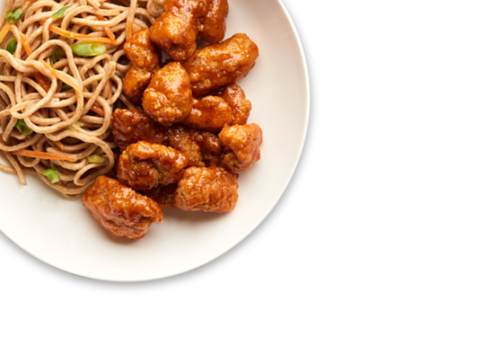

District Logo
September 2024
ROSCOE ISD MENU
 | MON |  | TUES |  | WED |  | THURS |  | FRI
2 |  | 3 |  | 4 |  | 5 |  | 6
9 |  | 10 |  | 11 |  | 12 |  | 13
16 |  | 17 |  | 18 |  | 19 |  | 20
23 |  | 24 |  | 25 |  | 26 |  | 27
30 |  | September 18th Rice Krispy Day! Get a plate, Get a Krispy!
Breakfast ​
FREE for all grades!​
$3.00 for ​
adult/staff​
​
Lunch
is $2.60 for
students​
$5.00 for​
adults/st​aff
Staff Menu
Coffee Bar
Grade 9-12
HOLIDAY
Cheesy Egg Biscuit
Waffle
Dorito Nachos/Churro
Chicken Tenders/Breadstick
Chicken Biscuit
Scone
Cereal/Side
Salisbury Steak/Gravy/Roll
Cheeseburger/Fries
Donut
Yogurt Smoothie/Side
BBQ Pork SDW/Fries
Beef Nachos
Breakfast Round
Breakfast SDW
Pizza
Spicy Chicken Basket/Breadstick
Grandparents Day
Cinnamon Biscuit
Sausage Pancake Bites
Cereal/Side
Chicken Fried Steak/Gravy/Roll
Cheeseburger/Fries
Breakfast Pizza
Muffin/Side
Chicken SDW/Fries
Max Sticks/Sauce
Cheesy Egg Biscuit
Cinnamon Roll
Hamburger/Fries
Chicken Tenders/Breadstick
Cheesy Chicken Biscuit
Muffin/Side
French Toast Sticks/Sausage
Beef Nachos
Scone
Bosco Stick
H. Must. Chicken Melt/Fries
Pizza/Breadstick
Breakfast Pizza
Breakfast Round
Mini Corn Dog/Mac & Cheese
Cheeseburger/Fries
PBJ
Sample: Chicken Katsu Bowl
Donut Holes
French Toast Sticks
Cereal/Side
Beef Spaghetti/Breadstick
Grilled Cheese
Sample: Chicken Katsu Bowl
Smoothie/Side
Breakfast Taco
Plowboy Bowl/Roll
Cheeseburger/Fries
Sample: Chicken Katsu Bowl
Pancake on a Stick
Waffle
BBQ Chicken SDW / Brdstick
Beef Nachos
Sample: Chicken Katsu Bowl
Ham Egg Cheese Biscuit
Pancake Bites
Cheesy Baked Penne/Breadstick
Pepperoni Pizza/Breadstick
Sample: Chicken Katsu Bowl
Muffin/Side
Cheesy Egg Biscuit
Cereal/Side
BBQ Pork SDW
Cheeseburger/Fries
Breakfast Burrito
French Toast Sticks
Cheese Quesadilla
Chicken Tenders/Breadstick
Sausage Biscuit
Churro Bites/Side
Chicken Alfredo/Garlic Toast
Cheeseburger/Fries
World School Milk Day
Chocolate Crescent
Breakfast Flatbread SDW
Chicken SDW/Fries
Beef Nachos
Dumpling Day
Sausage Pancake Bites
Breakfast Round
Spicy Chicken Pasta/Flatbread
Pizza/Breadstick
Grape Crescent
Cheesy Chicken Biscuit
Cereal/Side
Popcorn Chicken/Lomein
Popcorn Chicken/Roll
Cheeseburger/Fries
Menus are subject to change.
Breakfast Cereal/Side Served Daily!
Salad/Roll & PBJ
Are served Daily as a Meal
Burgers every Monday and Wednesday
Nachos Every Thursday
Pizza Every Friday
All Lunches Must Include Choice of:
Fruits and/or
Vegetable
And May Include:
1% Low-Fat Milk
This institution is an equal opportunity provider.

Slide 10
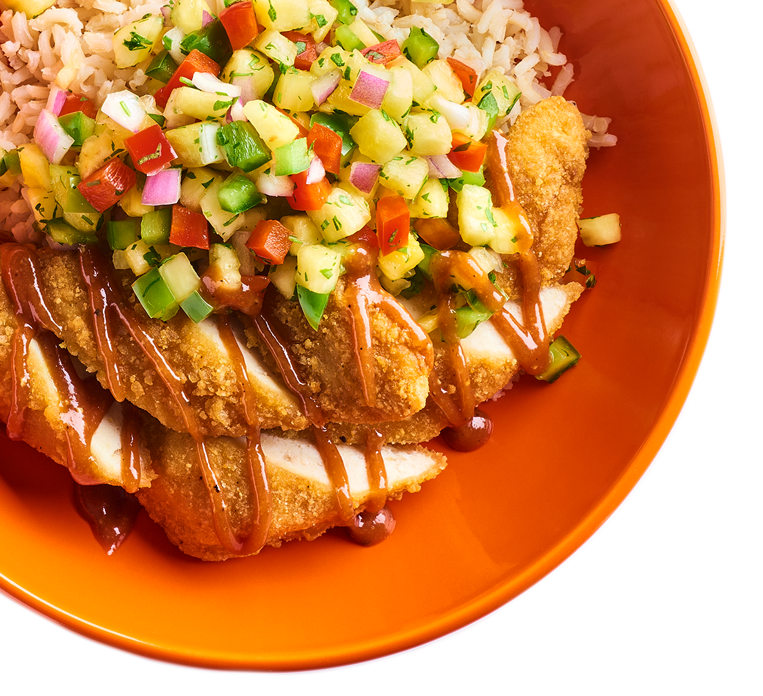
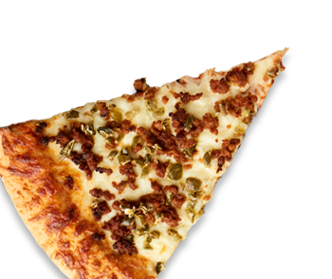
District Logo
October 2024
ROSCOE ISD MENU
 | MON |  | TUES |  | WED |  | THURS |  | FRI
 |  | 1 |  | 2 |  | 3 |  | 4
7 |  | 8 |  | 9 |  | 10 |  | 11
14 |  | 15 |  | 16 |  | 17 |  | 18
21 |  | 22 |  | 23 |  | 24 |  | 25
28 |  | 29 |  | 30 |  | 31
Breakfast ​
FREE for all grades!​
$3.00 for ​
adult/staff​
​
Lunch
is $2.60 for
students​
$5.00 for​
adults/st​aff
Staff Menu
Coffee Bar
Grade 9-12
Menu Item
Menu Item
Menu Item
Menu Item
Menu Item
Menu Item
Menu Item
Menu Item
Menu Item
Menu Item
Menu Item
Menu Item
Menu Item
Menu Item
Menu Item
Menu Item
Menu Item
Menu Item
Menu Item
Menu Item
Menu Item
Menu Item
Menu Item
Menu Item
Menu Item
Menu Item
Menu Item
Menu Item
Menu Item
Menu Item
Menu Item
Menu Item
Menu Item
Menu Item
Menu Item
Menu Item
Menu Item
Menu Item
Menu Item
Menu Item
Menu Item
Menu Item
Menu Item
Menu Item
Menu Item
Menu Item
Menu Item
Menu Item
Menu Item
Menu Item
Menu Item
Menu Item
Menu Item
Menu Item
Menu Item
Menu Item
Menu Item
Menu Item
Menu Item
Menu Item
Menu Item
Menu Item
Menu Item
Menu Item
Menu Item
Menu Item
Menu Item
Menu Item
Menu Item
Menus are subject to change.
Salad/Roll & PBJ
Are served Daily as a Meal
Burgers every Monday and Wednesday
Nachos Every Thursday
Pizza Every Friday
All Lunches Must Include Choice of:
Fruits and/or
Vegetable
And May Include:
1% Low-Fat Milk
This institution is an equal opportunity provider.

Slide 11
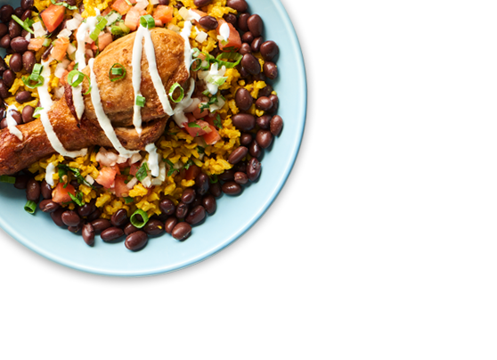

District Logo
November 2024
ROSCOE ISD MENU
 | MON |  | TUES |  | WED |  | THURS |  | FRI
 |  |  |  |  |  |  |  | 1
4 |  | 5 |  | 6 |  | 7 |  | 8
11 |  | 12 |  | 13 |  | 14 |  | 15
18 |  | 19 |  | 20 |  | 21 |  | 22
25 |  | 26 |  | 27 |  | 28 |  | 29
Breakfast ​
FREE for all grades!​
$3.00 for ​
adult/staff​
​
Lunch
is $2.60 for
students​
$5.00 for​
adults/st​aff
Staff Menu
Coffee Bar
Grade 9-12
Menu Item
Menu Item
Menu Item
Menu Item
Menu Item
Menu Item
Menu Item
Menu Item
Menu Item
Menu Item
Menu Item
Menu Item
Menu Item
Menu Item
Menu Item
Menu Item
Menu Item
Menu Item
Menu Item
Menu Item
Menu Item
Menu Item
Menu Item
Menu Item
Menu Item
Menu Item
Menu Item
Menu Item
Menu Item
Menu Item
Menu Item
Menu Item
Menu Item
Menu Item
Menu Item
Menu Item
Menu Item
Menu Item
Menu Item
Menu Item
Menu Item
Menu Item
Menu Item
Menu Item
Menu Item
Menu Item
Menu Item
Menu Item
Menu Item
Menu Item
Menu Item
Menu Item
Menu Item
Menu Item
Menu Item
Menu Item
Menu Item
Menu Item
Menu Item
Menu Item
Menu Item
Menu Item
Menu Item
Menus are subject to change.
All Lunches Must Include Choice of:
Fruits and/or
Vegetable
And May Include:
1% Low-Fat Milk
Salad/Roll & PBJ
Are served Daily as a Meal
Burgers every Monday and Wednesday
Nachos Every Thursday
Pizza Every Friday
This institution is an equal opportunity provider.

Slide 12
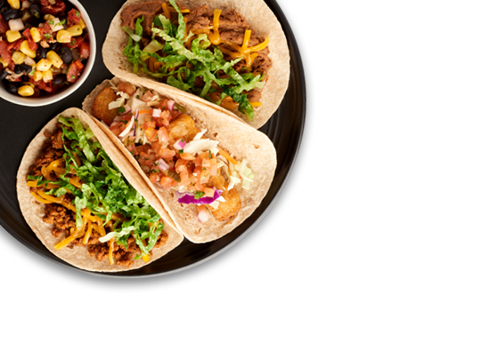

District Logo
December 2024
ROSCOE ISD MENU
 | MON |  | TUES |  | WED |  | THURS |  | FRI
2 |  | 3 |  | 4 |  | 5 |  | 6
9 |  | 10 |  | 11 |  | 12 |  | 13
16 |  | 17 |  | 18 |  | 19 |  | 20
23 |  | 24 |  | 25 |  | 26 |  | 27
30 |  | 31
Breakfast ​
FREE for all grades!​
$3.00 for ​
adult/staff​
​
Lunch
is $2.60 for
students​
$5.00 for​
adults/st​aff
Staff Menu
Coffee Bar
Grade 9-12
Menu Item
Menu Item
Menu Item
Menu Item
Menu Item
Menu Item
Menu Item
Menu Item
Menu Item
Menu Item
Menu Item
Menu Item
Menu Item
Menu Item
Menu Item
Menu Item
Menu Item
Menu Item
Menu Item
Menu Item
Menu Item
Menu Item
Menu Item
Menu Item
Menu Item
Menu Item
Menu Item
Menu Item
Menu Item
Menu Item
Menu Item
Menu Item
Menu Item
Menu Item
Menu Item
Menu Item
Menu Item
Menu Item
Menu Item
Menu Item
Menu Item
Menu Item
Menu Item
Menu Item
Menu Item
Menu Item
Menu Item
Menu Item
Menu Item
Menu Item
Menu Item
Menu Item
Menu Item
Menu Item
Menu Item
Menu Item
Menu Item
Menu Item
Menu Item
Menu Item
Menu Item
Menu Item
Menu Item
Menu Item
Menu Item
Menu Item
Menus are subject to change.
Salad/Roll & PBJ
Are served Daily as a Meal
Burgers every Monday and Wednesday
Nachos Every Thursday
Pizza Every Friday
All Lunches Must Include Choice of:
Fruits and/or
Vegetable
And May Include:
1% Low-Fat Milk
This institution is an equal opportunity provider.

